Slide 1
TYPES OF ARTIFICIAL POSTEIOR TEETH
Presented by
Dr. Gaurav Kharbanda

Slide 2
Types of posterior teeth for complete denture:
Two main types:
1. standard or anatomic tooth
2. non-anatomic tooth

Slide 3
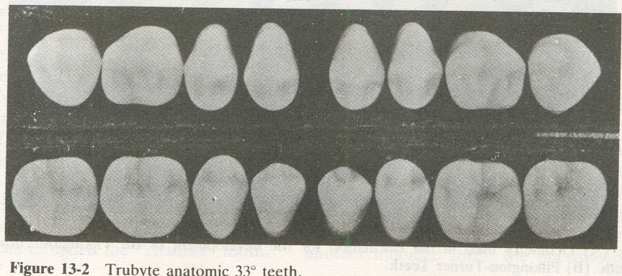
STANDARD OR ANATOMIC TEETH:
TRUBYTE TEETH (1914) - Dr. Alfred Gysi
cusp angle of 33°.
He designed anatomic teeth which closely resembled unblemished natural teeth and were intended for tight intercuspation for Angle’s class I occlusion.

Slide 4
STANDARD OR ANATOMIC TEETH:
2. MODIFIED ANATOMIC TEETH (1932) – Pilkington and Turner. Slightly shallow cusps of 30° . These were not as tightly interlocked as Trubyte teeth.

Slide 5
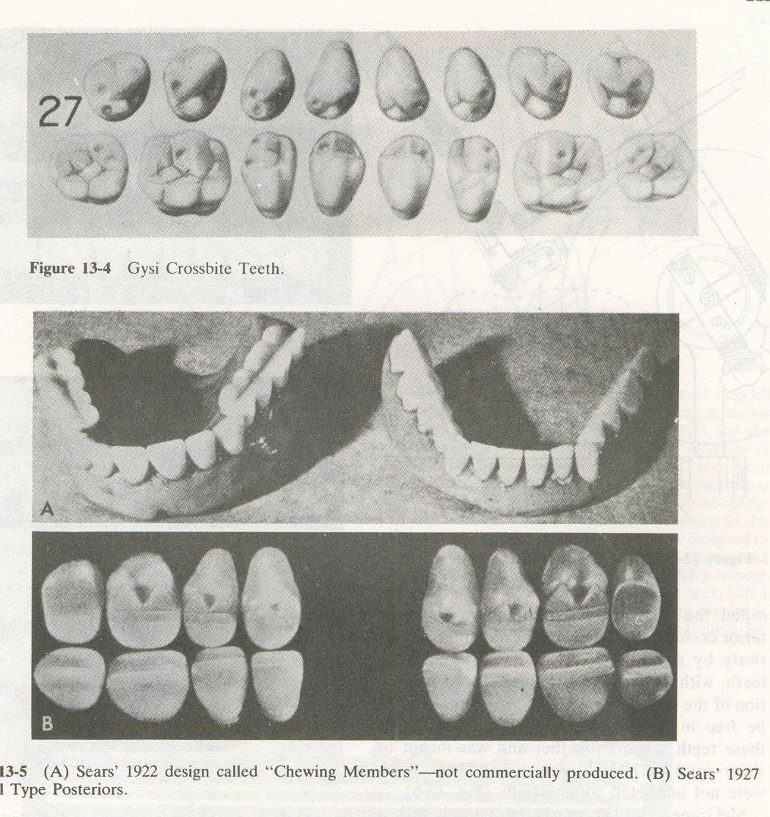
MODIFIED ANATOMIC TEETH: ( 0-30°)
MODIFIED CROSS BITE POSTERIOR – Gysi (1927). The maxillary buccal cusp was almost eliminated, resulting in one prominent lingual cusp occluding into the anatomic lower tooth. “Mortar and pestle action”

Slide 6
MODIFIED ANATOMIC TEETH: ( 0-30°)
2. CHANNEL TOOTH – Victor Sears (1922). Maxillary occlusal surfaces consisted of deep channel that ran mesiodistally the entire length of the four posterior teeth.
Effectively it was a single ridge that ran uninterrupted the entire length of the occlusal table.

Slide 7
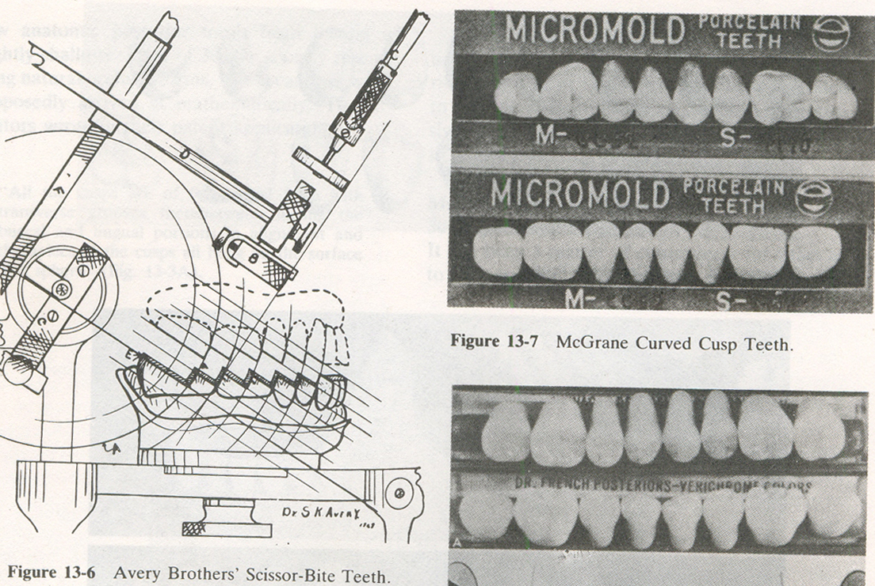
MODIFIED ANATOMIC TEETH: ( 0-30°)
“SCISSOR BITE” form – Avery (1930). Posterior occlusal surface was locked anteroposteriorly by grinding steps on the surface of the teeth. Occlusion with the these teeth was meant for shearing food.

Slide 8
MODIFIED ANATOMIC TEETH: ( 0-30°)
“CURVED CUSP” posterior tooth – McGrane (1936). These teeth were designed to lock anteroposteriorly and free laterally.

Slide 9
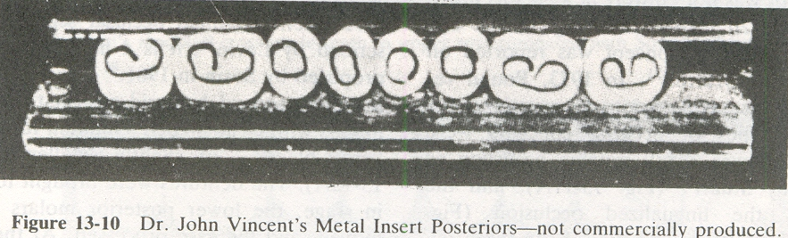

MODIFIED ANATOMIC TEETH: ( 0-30°)
5.METAL INSERT POSTERIORS – John Vincent (1942). Stainless steel inserts in posteriors were gold solder which was later replaced with. Advantage claimed was that these teeth were self adjusting to wear.
6. Modified teeth for Lingualized occlusion – Payne.

Slide 10
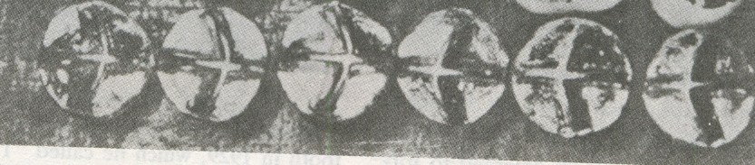
MODIFIED ANATOMIC TEETH: ( 0-30°)
7. CROSS BLADES – Sosin (1961) – replaced the maxillary and mandibular second premolar and both molars with cleat shaped Vitallium forms called “cross blades” of slightly smaller size. An increase in masticatory efficiency is claimed.

Slide 11
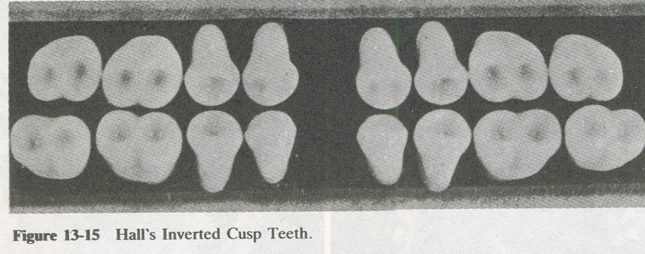
NON ANATOMIC TEETH
1. INVERTED CUSP TEETH – Hall (1929). Tooth was flat with concentric cone shaped depressions on the occlusal surface that were like inverted cusps. Claimed to provide effective shredding action on the food as the upper and lower teeth sheared by one another.

Slide 12
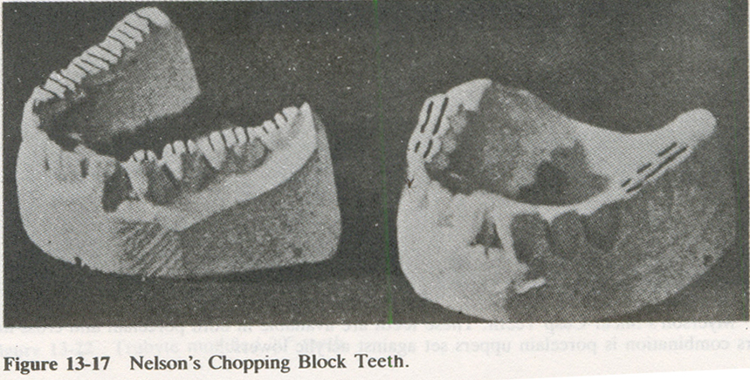
NON ANATOMIC TEETH
2. CHOPPING BLOCK – Nelson (1934). These were flat occlusal surface teeth with numerous ridges that ran transversely on the mandibular teeth and mesiodistally on the maxillary teeth. The perpendicular orientation of these ridges increased the masticatory efficiency.

Slide 13
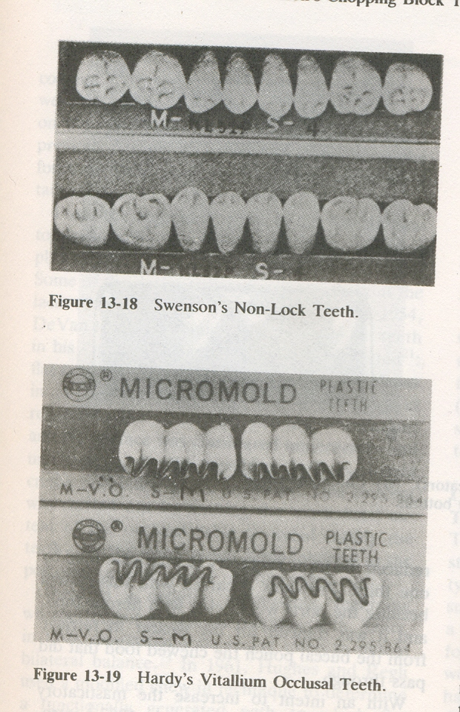
NON ANATOMIC TEETH
3.NON LOCK – Swenson (1939) these were flat teeth with sluiceways for shredding and allowing food to clear the occlusal table, as a modest buccal and lingual incline was provided.

Slide 14
NON ANATOMIC TEETH
4. “VO” / Vitallium Occlusal – Hardy (1946). These teeth were produced in resin blocks of three posterior teeth simulating a buccal façade of two bicuspids and one molar. A narrow zigzag of Vitallium was embedded on the occlusal surface that ran mesiodistally.

Slide 15
NON ANATOMIC TEETH
5. SHEAR CUSP TEETH – Myerson (1951). First cross linked acrylic tooth in flat occlusal scheme
6. COE MASTICATORS – Cook (1952). The second premolar and the first molar were flat stainless steel castings with holes on the occlusal surfaces that exited diagonally to a port on the buccal surface.

