Slide 1
RETRACTIONS
and
IMPRESSIONS

Slide 2
Retractions…

Slide 3
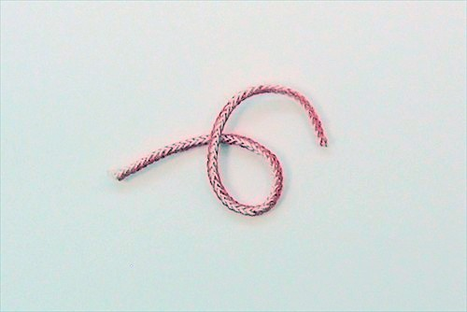
Gingival retraction cord
Used during or after the preparation of the teeth .
Cord is inserted gently below the gumline into the gingival sulcus, around the tooth that has been prepared for the crown or FPD.

Slide 4
Cord is primarily used to push the gum tissue away from the prepared margins of the tooth, in order to create an accurate impression of the teeth.

Slide 5
Pieces of cotton or polyester are braided together to create a specific diameter.
Some brands of gingival retraction cord are pre-soaked in hemodent, a liquid used to stop minor bleeding of the gum tissue.

Slide 6
A retraction cord packer is used to place the cord around the gum line during a crown procedure because it eliminates blood from surrounding the tooth during the preparation.
Allows to see the margins of the tooth as well as to make a perfect impression for the permanent crown.

Slide 7
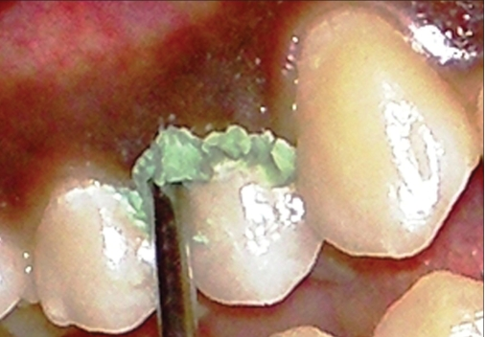
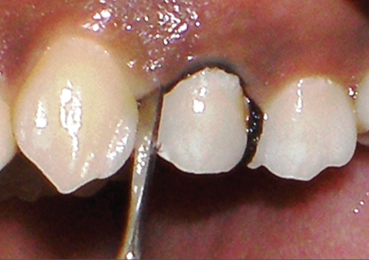
Eg:
Expasyl
Magic Foam Cord
Impregnated retraction cord

Slide 8
Impressions…

Slide 9
REQUIREMENTS
They should be fluid enough to adapt to the oral tissues
They should be viscous enough to be contained in the tray
while in the mouth they should transform into rigid state within reasonable time (approximately 7min)
The set impression should not distort when removed.

Slide 10
Impression should be dimensionally stable till the cast is poured.
Material should be biocompatible
Material should be economical
Should be compatible with die and cast materials
Should record the teeth and tissue accurately

Slide 11
Chemically there are four types of elastomers
Polysulfide
Condensation polymerizing silicone
Addition polymerizing silicone
Polyether

Slide 12
Each type is further divided into four viscosity classes
Light body
Medium / regular body
Heavy body
Putty

Slide 13
GENERAL PROPERTIES
Excellent reproduction of surface details. The low viscosity is able to record find details
They are hydrophobic. So oral tissues in the area of impression should be dry.
Co-efficient of thermal expansion of elastomers is high. So thermal contraction of set material occurs when transferred to room temperature

Slide 14
Tear strength is excellent. So impressions can be removed from thin areas.
Shelf life of elastomers is good
Dimensional stability

Slide 15
IMPRESSION MAKING WITH ELASTOMERS
It involves five steps
Preparing a tray
Preparing the material
Making impression
Removing the impression
Preparing stone casts and dies

Slide 16
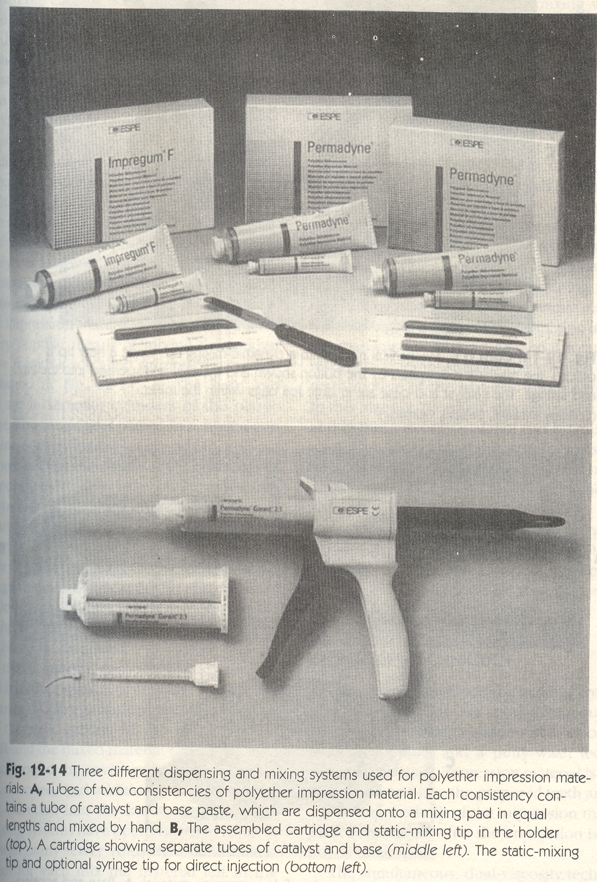

Slide 17
Making of impression
  Initially tray is coated with adhesive that forms bond between tray and impression material. Slightly roughened surface of tray increases adhesion.

Slide 18
METHODS OF MAKING IMPRESSION
Three techniques
Single mix technique
Multiple mix technique
Reline technique

Slide 19
Single Mix technique:
Viscosity used is regular body
Method:
The paste is mixed and part of it is loaded into tray and part into syringe. The syringe material is then injected on to the prepared area. Then tray is seated over it.

Slide 20
Multiple mix technique:
Viscosity used is heavy body and light body
Method:
The two viscosities are mixed simultaneously on separate pads. Heavy body is loaded onto the tray and light body in to syringe. The syringe material is injected into area of preparation. Tray with heavy body is seated over it.

Slide 21
Reline technique:
Viscosity used is putty and light body
Two stage procedure putty wash technique
Single stage procedure

Slide 22
For two stage procedure, thick putty material is placed in stock tray and a preliminary impression is made.
This forms an intra oral custom tray. Space for light body or was is provided wither by cutting away some of the putty or by using thin polyethelene sheet as a spacer between putty and prepared teeth.
A mix of thin wash material is placed into putty and putty was combination tray is seated finally to make impression.

Slide 23
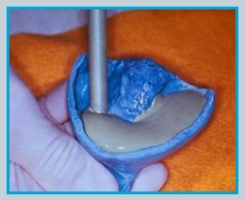
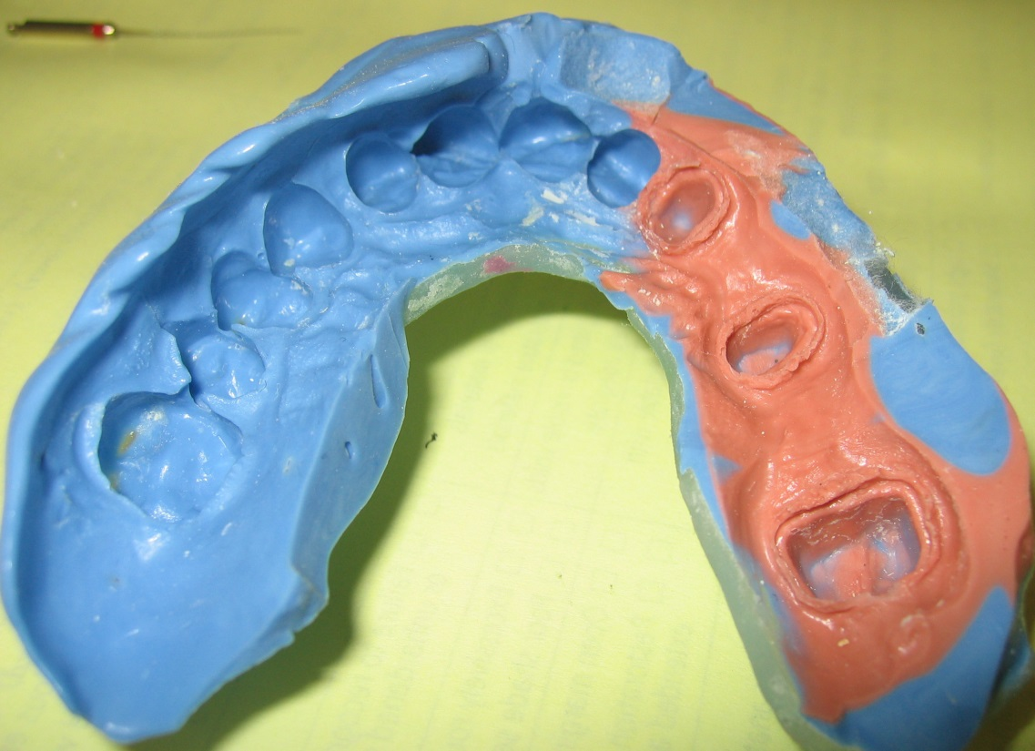

Slide 24
For single stage procedure, was material is syringed into place and then unset putty is seated over light body but the disadvantage is that putty may displace light body.

Slide 25
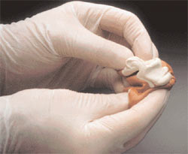
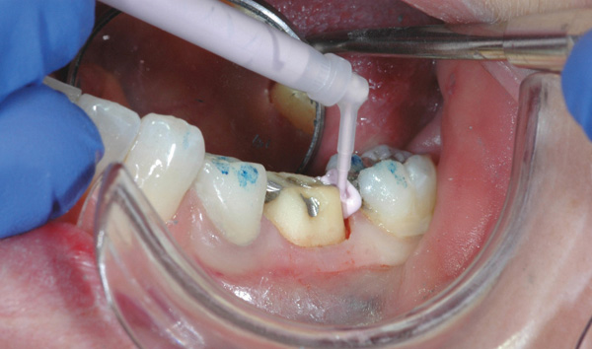

Slide 26
Removal of the impression:
The material is checked for set by probing with the blunt instrument. Then impression is dislodged from the mouth with a steady pressure

Slide 27
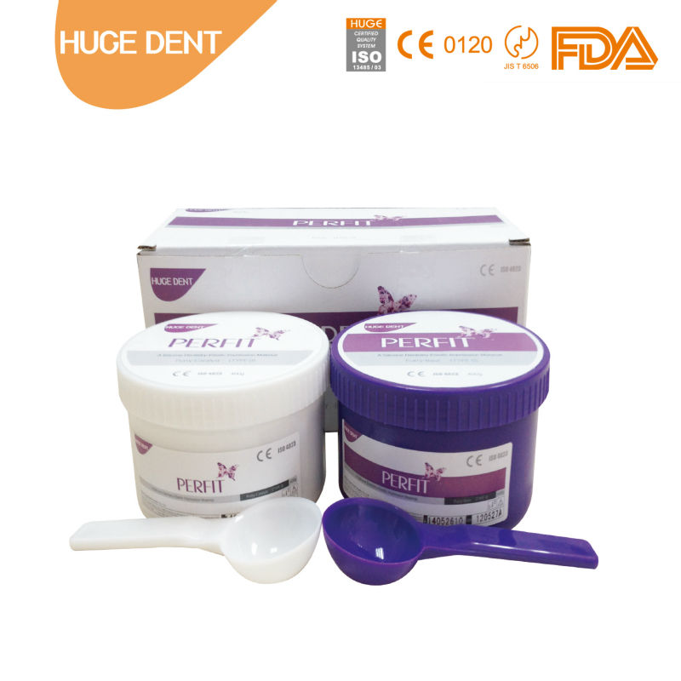
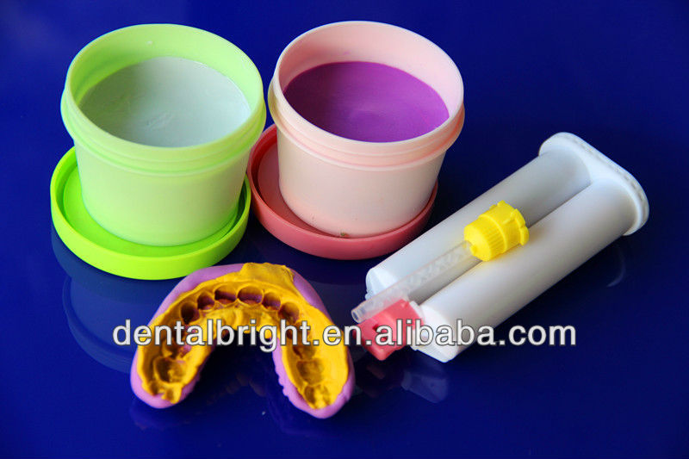

Slide 28
