Slide 1
OBJECTIVES OF IMPRESSION MAKING
IN
COMPLETE DENTURES

Slide 2
Introduction
Impressions In Complete Denture
“The journey of a thousand miles begins with one step”
Iao Tsu
Correct impression with judicious application of knowledge and experience is the stepping stone for a successful prosthesis.

Slide 3
Definitions
Impressions In Complete Denture
A negative likeness or copy in reverse of an object; an imprint of the teeth and adjacent structures for use in dentistry (GPT-8)
An impression is a record of negative form of tissues of oral cavity that makeup the basal seat of denture (BOUCHER)

Slide 4
Impressions In Complete Denture
An impression is a negative registration of entire denture bearing, stabilizing and border seal areas present in an edentulous mouth. (LEVIN)
An imprint or negative likeliness of teeth, of edentulous areas where teeth have been removed, or of both, made in plastic material that becomes relatively hard or set while in contact with these tissues. (WINKLER)

Slide 5
Basic REQUIREMENTS
Impressions In Complete Denture
Knowledge of the oral anatomy.
Knowledge and understanding of material.
Knowledge of a reliable and basic technique.
Skill
Patient management.
Bernard Levin. Complete denture impressions.

Slide 6
Objectives OF IMPRESSION making
Impressions In Complete Denture
Preservation of residual ridge
Retention
Stability
Support
Esthetics
Boucher . Prosthodontic treatment for edentulous patients

Slide 7
Preservation of residual ridge
Impressions In Complete Denture
“Our primary objective in restorative services should be the perpetual preservation of what remains of the masticatory apparatus rather than providing meticulous restoration of what is missing”
Achieved by covering maximum supporting areas and applying pressure within physiological limits.

Slide 8
Retention
Impressions In Complete Denture
Quality inherent in the dental prosthesis acting to resist the forces of dislodgement along the path of placement.
Resists the forces of gravity, the adhesiveness of foods and forces associated with opening of jaws.

Slide 9
Impressions In Complete Denture
FACTORS
Adhesion
Cohesion
Interfacial Surface Tension
Undercuts
Peripheral Seal And Atmospheric Pressure
Oral And Facial Musculature

Slide 10
STABILITY
Impressions In Complete Denture
Quality of denture to be firm, steady, or constant, to resist displacement by functional horizontal or rotational stresses.
Brill’s factor –
Maximum area of coverage
Intimacy of contact
Equalization of pressure

Slide 11
Impressions In Complete Denture
According to Boucher –
Size and form of basal seat.
Quality of final impression.
Proper location and arrangement of artificial teeth
Boucher . Prosthodontic treatment for edentulous patients

Slide 12
Support
Impressions In Complete Denture
Resistance of denture to vertical components of mastication and occlusal forces applied in a direction towards the basal seat.
Enhanced by placing pressure selectively in harmony with the resiliency of tissues and using maximum coverage within normal functional limits

Slide 13
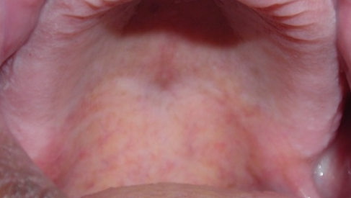
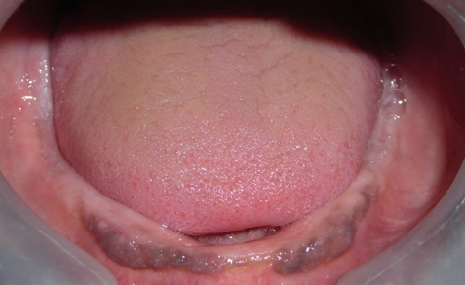
Impressions In Complete Denture
AREAS OF SUPPORT
Primary: Areas of the edentulous ridge that are at right angles to occlusal forces and usually don’t resorb easily .
Maxillary: - Posterior ridges
Mandibular: - Buccal shelf,
Bernard Levin. Complete denture impressions.

Slide 14

Impressions In Complete Denture
Secondary: The areas of edentulous ridge that are at right angles to occlusal forces but resorb under load.
Maxillary and Mandibular: Anterior ridge and all ridge slopes.

Slide 15
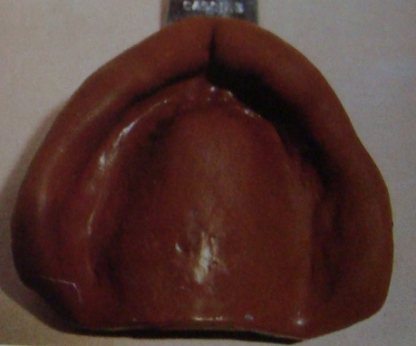
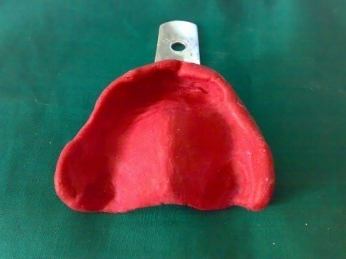
ESTHETICS
Impressions In Complete Denture
Border thickness should be varied with the needs of each patient in accordance with the extent of residual ridge loss.
The vestibular fornix should be filled, but not overfilled, to restore facial contour.

Slide 16
Theories of impression making
Impressions In Complete Denture
    Definite pressure
    Minimal pressure
    Selective pressure

Slide 17
Definite pressure technique
Impressions In Complete Denture
Also known as pressure technique / mucocompressive technique and was advocated by Green Brothers.
Application of definite pressure while making impressions.
Principle – Denture supporting tissues should be displaced while making impression because these tissues will displaced during mastication
Bernard Levin. Complete denture impressions.

Slide 18
Impressions In Complete Denture
This can be made by –
Trays without space for impression material or
Made in materials with reduced flow (modeling compound/wax)
Objective – To attain better retention of the denture by compression of the tissues under pressure.

Slide 19
Impressions In Complete Denture
Retention is achieved by atmospheric pressure together with intimate tissue contact and peripheral seal.
Advantages –
Good retention
Positive peripheral seal
Equal distribution of pressure.

Slide 20
Impressions In Complete Denture
Drawbacks –
Dentures are in contact for short period of time.
Excessive pressure is applied most often, this results in good initial retention but bone resorption later.
Dentures interferes with the blood supply of the basal seat.
Rebound phenomenon of tissues.
Halperin A.R. Mastering the arts of complete denture

Slide 21
Minimal pressure technique
Impressions In Complete Denture
Also known as pressureless / mucostatic technique.
The discovery of the mucostatic principle is credited to Harry L. Page, an engineer (1938)
The word was coined by Dr. Carrol W. Jones.
Richardson (1886) - Mentioned the necessity of making impressions of tissues at rest.

Slide 22
Impressions In Complete Denture
Based on Pascal’s law.
It states that, ‘pressure on a confined liquid will be transmitted throughout the liquid in all directions’.
According to this concept, the mucosa, being more than 80% water, will react like a liquid in a close vessel and thus cannot be compressed.

Slide 23
Impressions In Complete Denture
Impression material should record, without distortion every detail of mucosa.
Interfacial surface tension - only retentive means of importance.
Mucostatics further demanded that a metal base should be used.

Slide 24
shortcomings
Interfacial surface tension is dependent on cohesion and adhesion.
Closed container ????
No peripheral seal
Less coverage of basal seat area
M.M.Devan. Basic principles in impression making. JPD-1952;2;1;26.

Slide 25
Selective pressure
Impressions In Complete Denture
Given by Boucher.
Combines principles of both pressure and non pressure technique.
Certain areas are better adapted to bear the load of mastication.
Primary and secondary stress bearing areas.

Slide 26
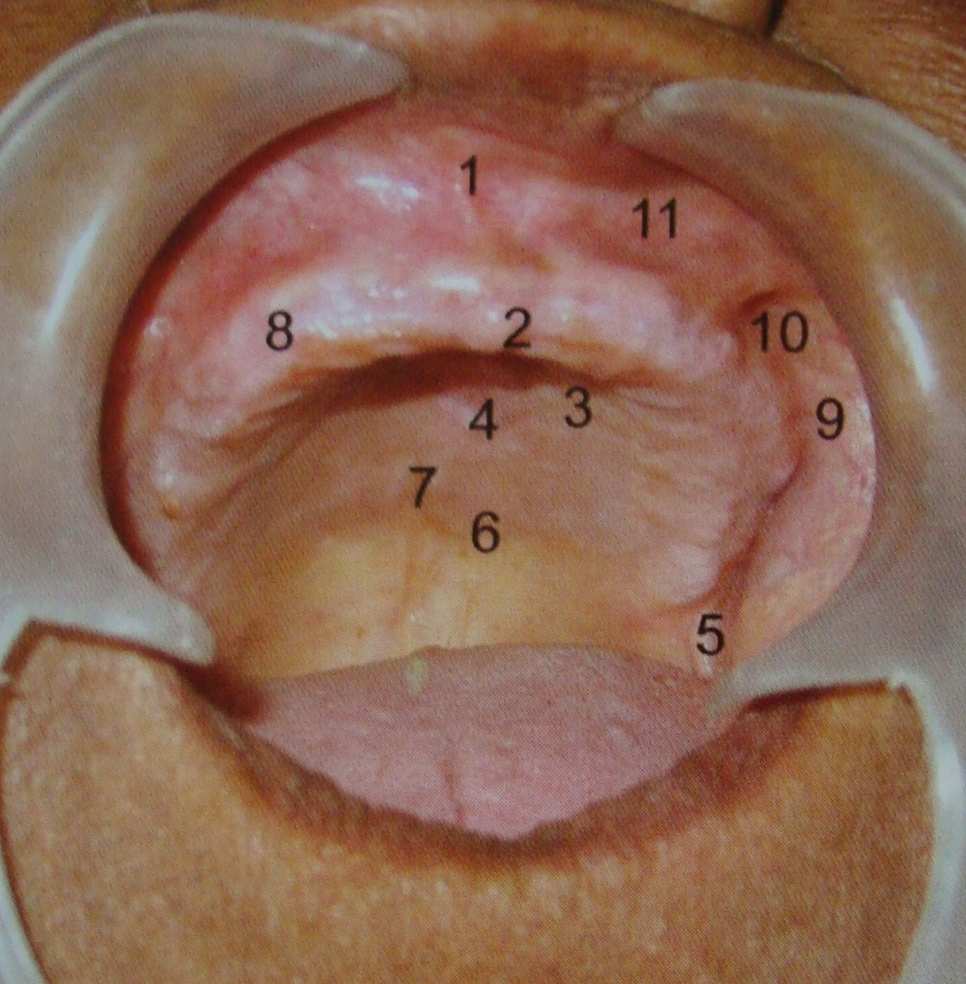
Maxillary landmarks
Impressions In Complete Denture
1. Labial frenum
2. Incisive papilla
3. Palatal Rugae
4. Midpalatine Raphe
5. Hamular Notch
6. Posterior palatal seal area
7. Fovea palatinae
8. Residual alveolar ridge
9. Buccal sulcus
10. Buccal frenum
11. Labial Sulcus

Slide 27
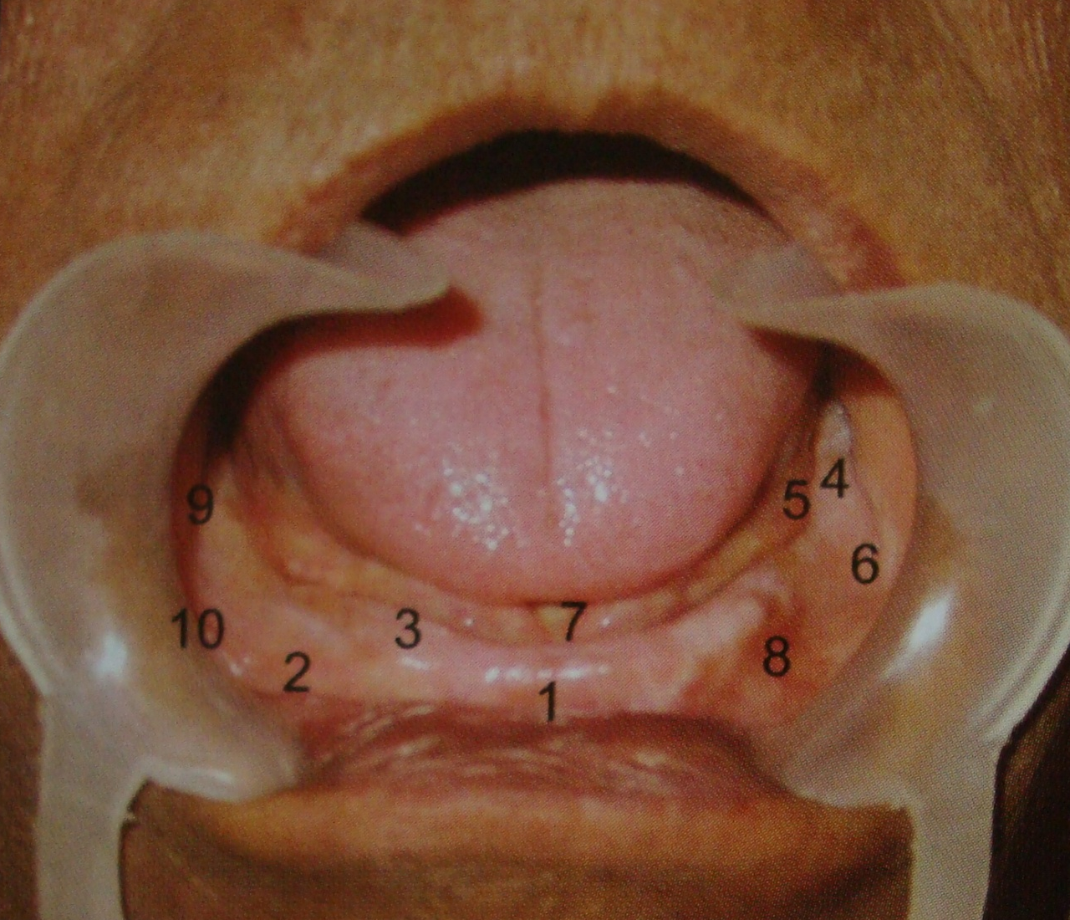
Mandibular landmarks
Impressions In Complete Denture
1. Labial frenum
2. Labial Sulcus
3. Residual alveolar ridge
4. Retromolar pad
5.Distolingual sulcus
6. Buccal shelf area
7. Lingual frenum
8. Buccal frenum
9. Massetric region
10. Buccal sulcus

Slide 28


Impressions In Complete Denture
Primary stress bearing areas
Maxilla : Posterio-lateral slope of palate
Crest of alveolar ridge
Mandible : Buccal shelf area.

Slide 29
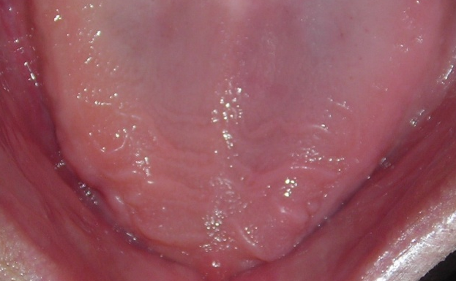

Impressions In Complete Denture
Secondary stress bearing areas
Maxilla - Rugae area and ridge slopes.
Mandible – Residual ridge

Slide 30
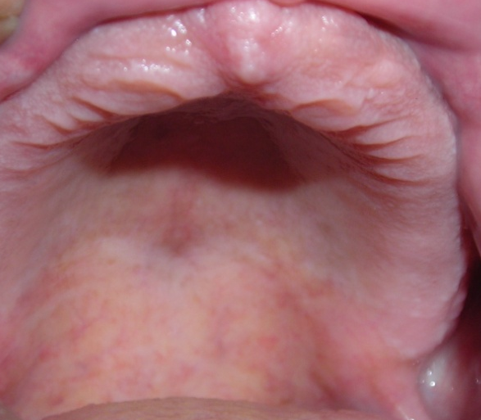
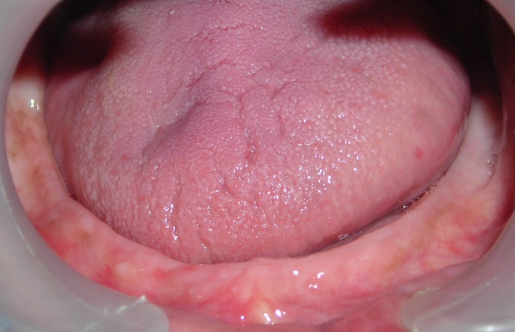
Impressions In Complete Denture
Relief areas
Areas requiring minimum or no
pressure –
Incisive papilla,
Midpalatine suture,
Crest of the mandibular residual
ridge.

Slide 31
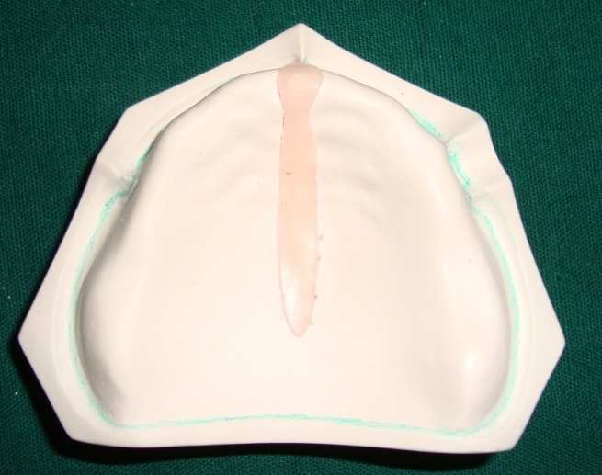
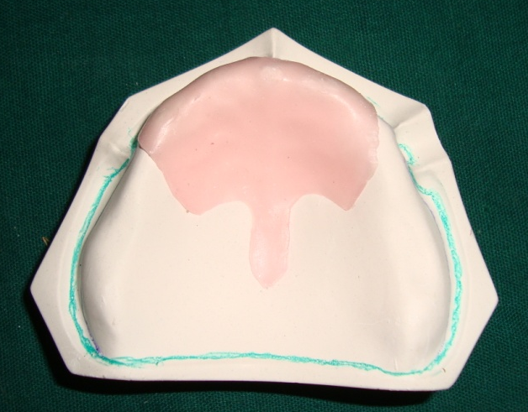
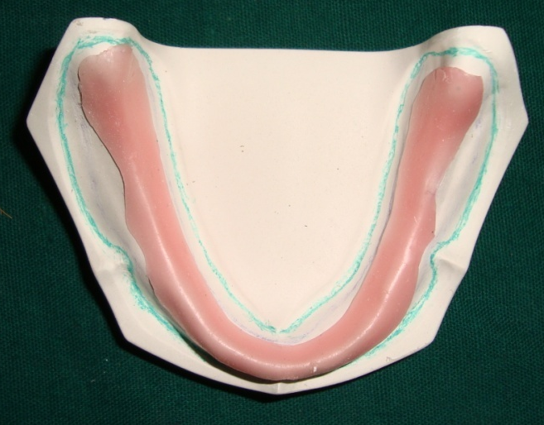
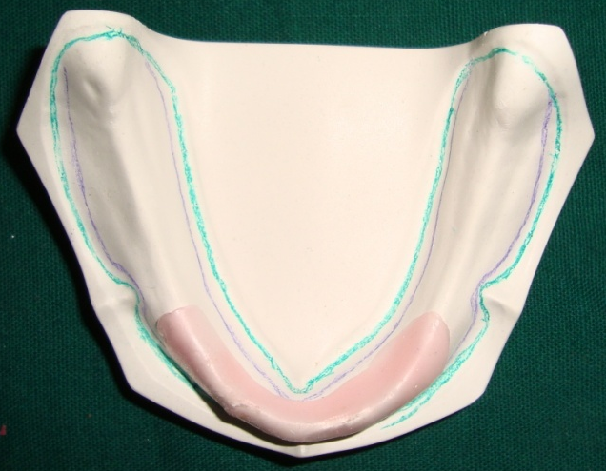
spacers
Impressions In Complete Denture

Slide 32
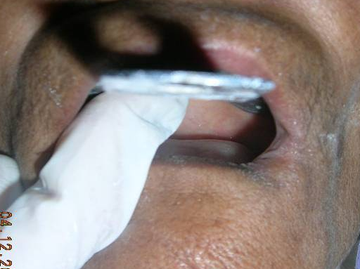
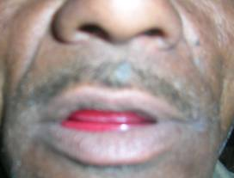
Classification
Impressions In Complete Denture
Amount of pressure used
    Definite pressure
    Minimal pressure
    Selective pressure
    Open mouth
    Closed mouth

Slide 33
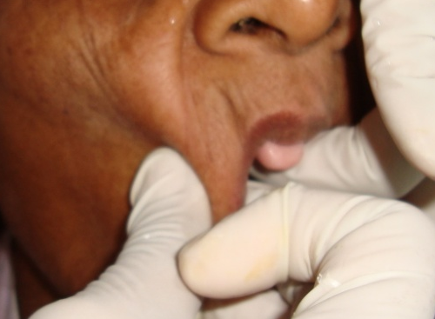
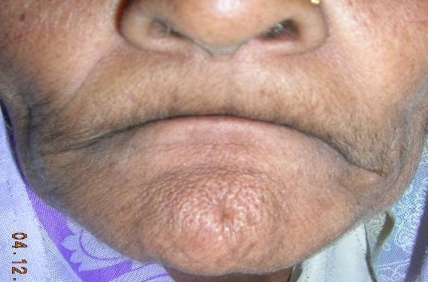
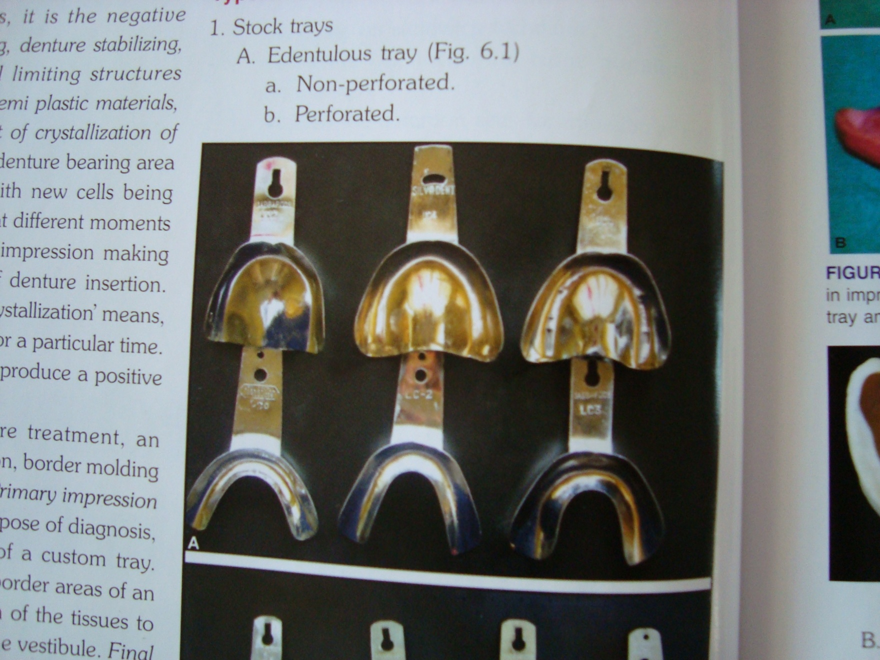
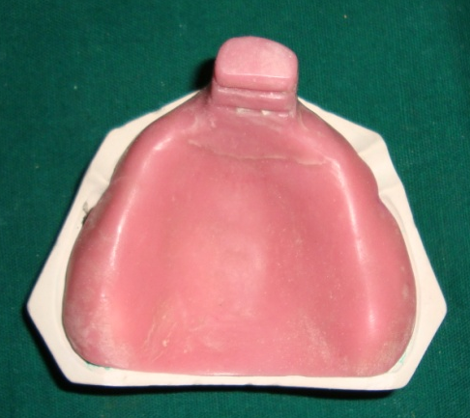
Impressions In Complete Denture
Hand manipulation
Functional movements
Stock tray
Custom tray

Slide 34

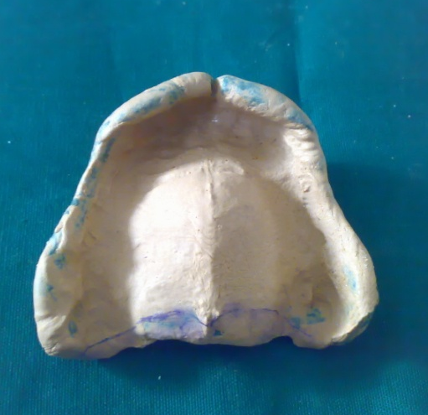
Impressions In Complete Denture
Preliminary impression
Secondary impression

Slide 35
Trays
Impressions In Complete Denture
“A device which is used to CARRY, CONFINE and CONTROL an impression material while making an impression”
        (GPT-8)
        FACTORS TO BE CONSIDERED –
        Tray should cover all the denture bearing areas
        Maxilla - The tuberosity and hamular notch.
        Mandible – Retromolar pad

Slide 36
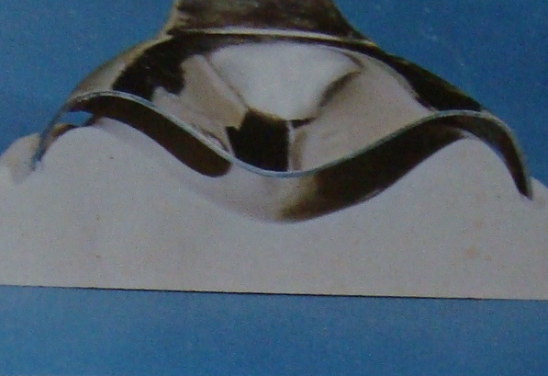
Impressions In Complete Denture
Sufficient space between the tray and the basal seat.
Adequate amount of clearance in flange area.
TYPES OF TRAYS –
Stock Trays
Custom Trays

Slide 37

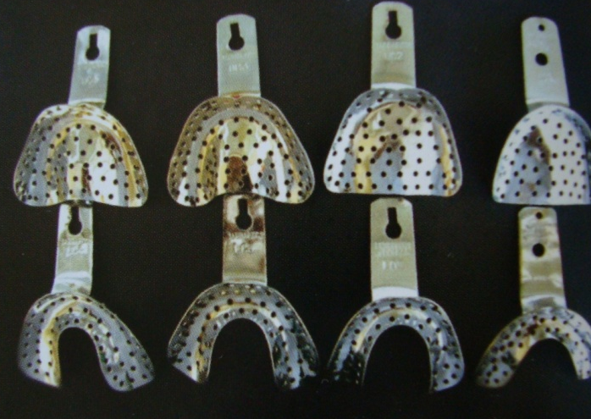
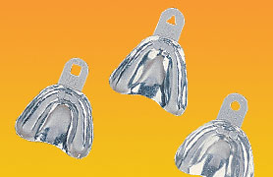
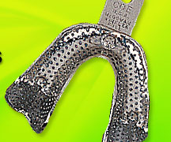
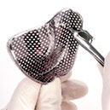
STOCK TRAYS
Impressions In Complete Denture
Solid trays
Perforated trays
Aluminium STOK trays
McGowan – Winkler trays

Slide 38
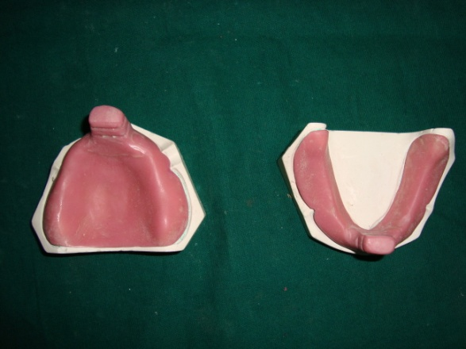
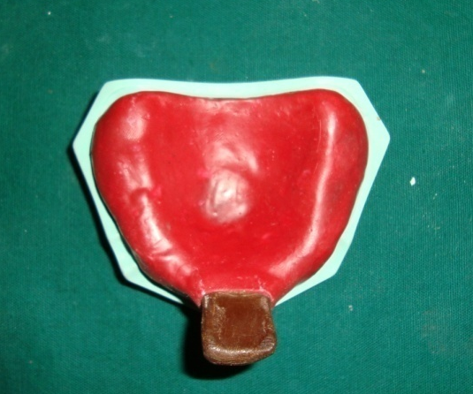
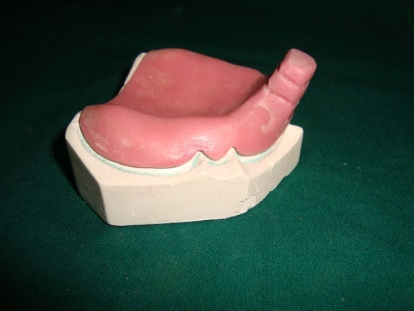
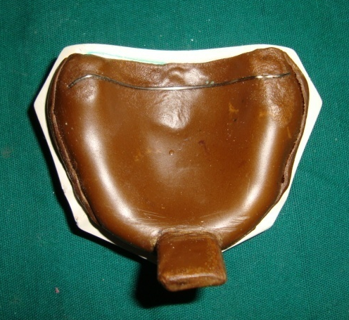
Custom trays
Impressions In Complete Denture
Cold cure acrylic
Shellac
Tray compound

Slide 39
Steps
Impressions In Complete Denture
Conditioning of tissues
Treatment of any inflammation if present.
If patient is old denture wearer then, should stop wearing denture atleast 48 hrs before impression making.
Use of tissue conditioner if abused tissues are present.

Slide 40
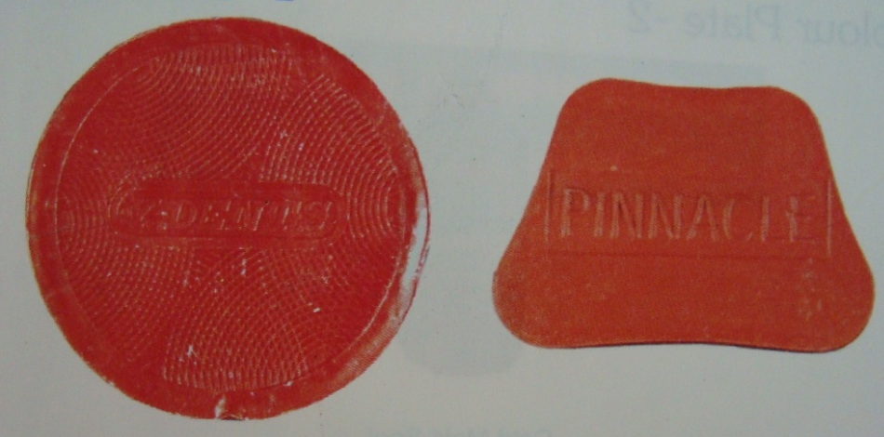
Preliminary impression
Impressions In Complete Denture
Tray selection
Material for impression – Impression compound
Alginate

Slide 41
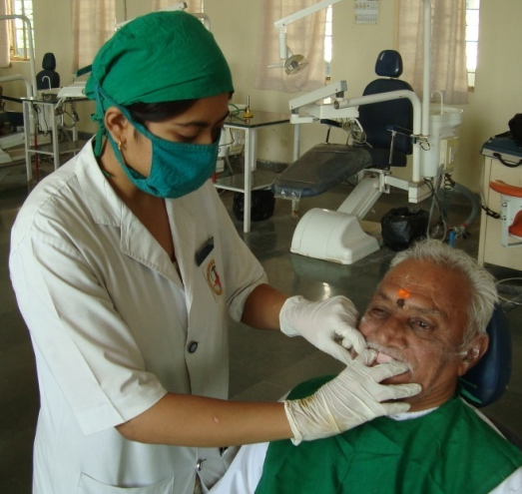
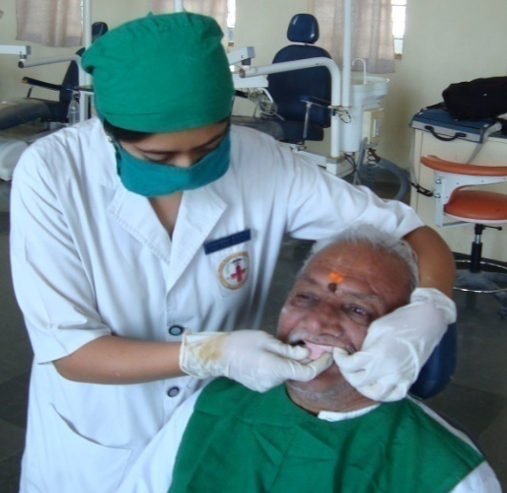
Impressions In Complete Denture
Patient- Operator position
Patients face at operators elbow level
For maxillary impression - On right side and little behind patient
For mandibular impression - On right side and front of patient

Slide 42
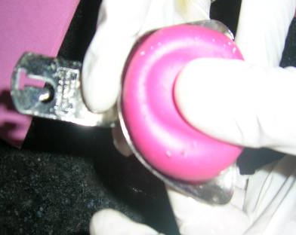
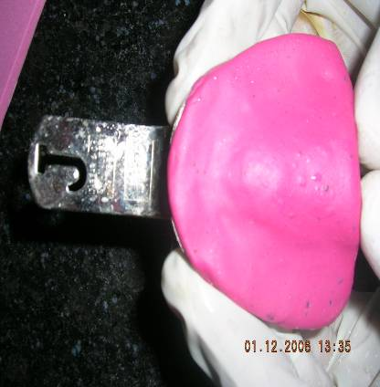
Impressions In Complete Denture
Making Impression
Maxillary
Loading the tray

Slide 43
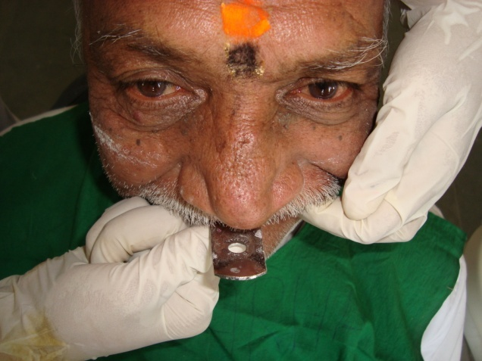
Impressions In Complete Denture
Mouth opened, upper lip elevated and tray is carried upward anteriorly in position with labial frenum as guide.
The handle of the tray should be divided into two equal halves in midline of face.
Tray seated till in contact with PPS then pressed anteriorly.
Moulding of borders started

Slide 44
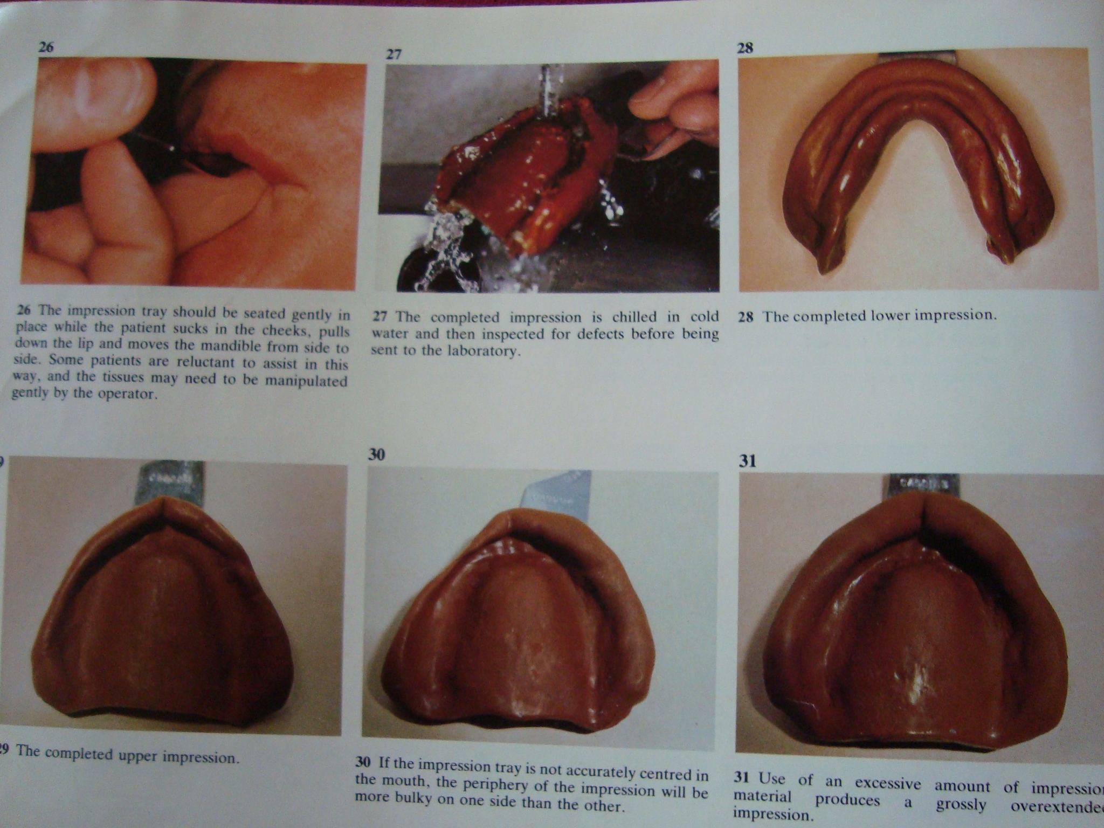
Impressions In Complete Denture
Labial and buccal vestibules molded by asking patient to suckdown.
Also the functional manipulation of lips and cheeks done.
Patient asked to move mandible from side to side to record Coronoid process on slopes of buccal vestibules.

Slide 45
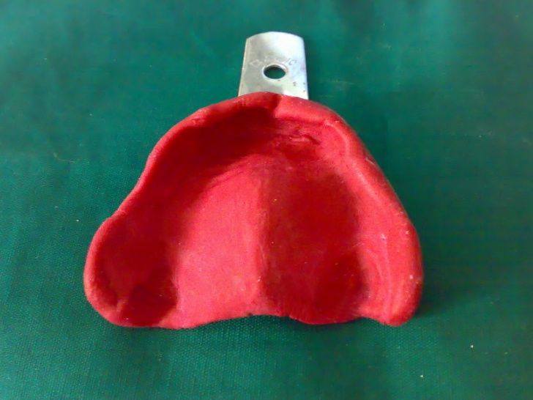
Impressions In Complete Denture
Washing the impression
Completed impression

Slide 46
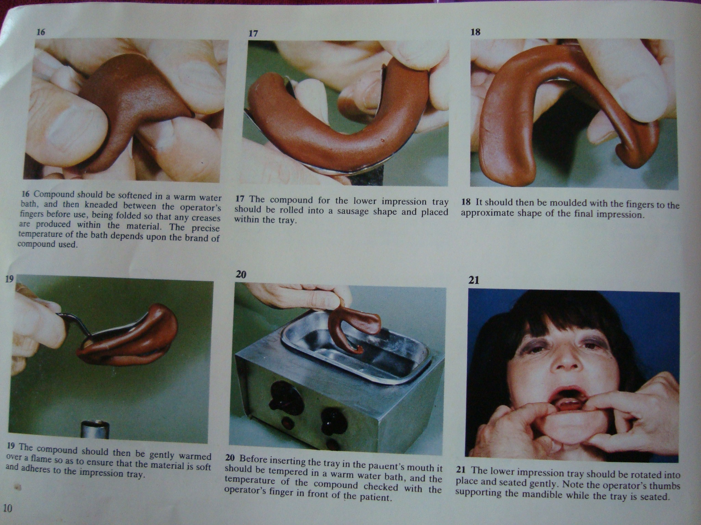
Impressions In Complete Denture
Mandibular
Loading Of Tray

Slide 47
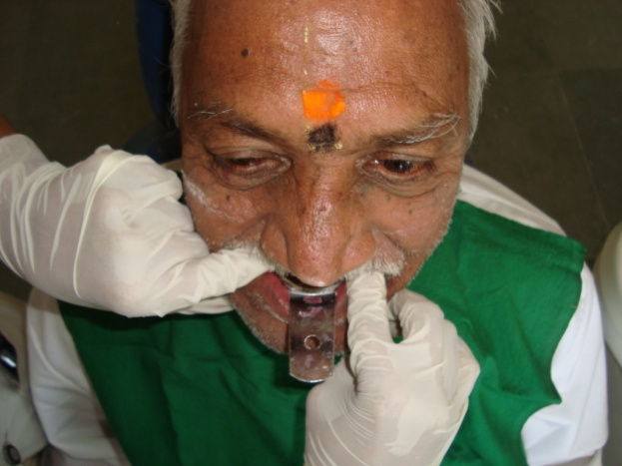
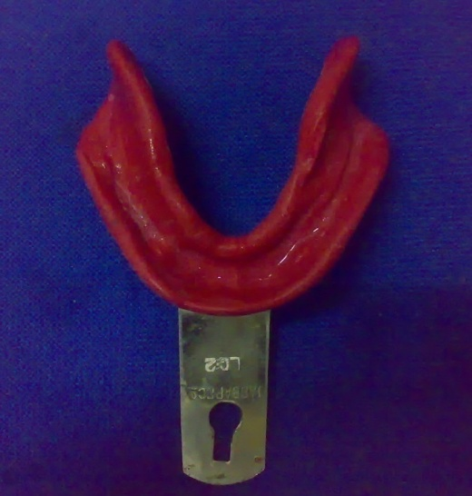
Impressions In Complete Denture

Slide 48
THANK YOU

