Slide 1
Occlusion
In
Removable Partial Denture
Dr. Mansi Oswal

Slide 2
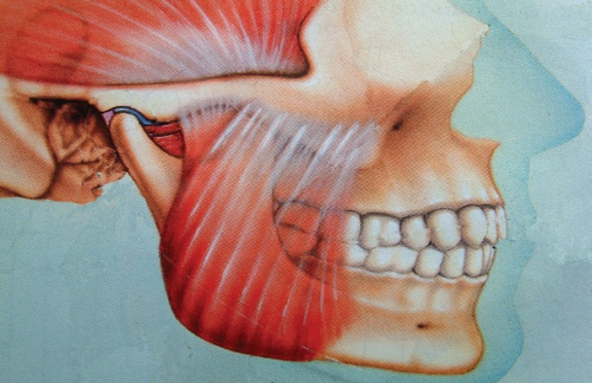
INTRODUCTION
For proper functioning of the masticatory apparatus, each and every component of stomatognathic system should work in coordination.
Neuromusc--ular structures
Teeth
TMJ

Slide 3
When treating a patient with a removable partial denture, the natural and artificial teeth, both functionally and esthetically, must coexist in a harmonious relationship.
Hence restoration of occlusion is a very critical and important step in partially edentulous conditions.

Slide 4
OCCLUSION
‘Occludere’ (Latin) – To close
Definition : ‘The static relationship between the incising or masticating surfaces of the maxillary or mandibular teeth or tooth analogue’.
-(GPT-8)

Slide 5
“ In removable partial dentures occlusal stresses are directly transmitted to abutment teeth and surrounding structures which may be more damaging then stresses found in complete denture.”
John Ivanhoe, Kevin Plummer; Removable partial denture occlusion. DCNA 48:667; 2004

Slide 6
STAGES OF INCORPORATION OF OCCLUSION IN PARTIAL DENTURES
Analysis of Occlusion of Remaining Natural Teeth
Equilibration of Natural Teeth
Occlusion of Artificial teeth
Co-ordination of the occlusal pattern.
Albert Colman; Occlusal requirements for removal partial dentures. J Prosthet Dent 17:155; 1967

Slide 7
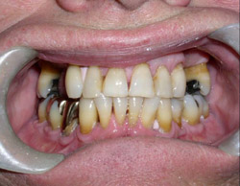
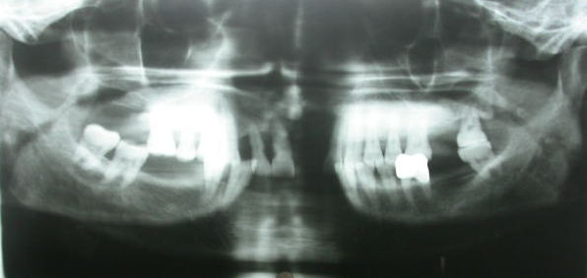

DIAGNOSIS AND TREATMENT PLANNING
Medical and Dental History
Complete Clinical Examination
Radiographs and Diagnostic Casts
  Provides the information regarding:
  Condition of existing teeth
  Existing occlusal status.
  Correction of occlusal dysfunction
John Ivanhoe, Kevin Plummer; Removable partial denture occlusion. DCNA 48:667; 2004

Slide 8
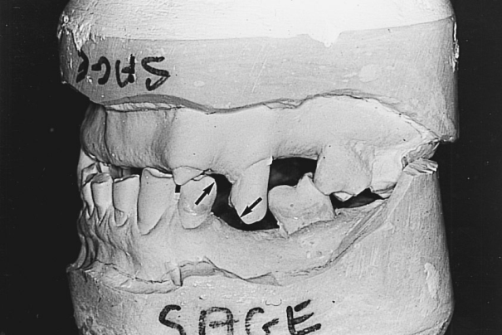

MOUNTED DIAGNOSTIC CASTS
Type of occlusion
Centric relation and maximum intercuspation
Plane of occlusion
Compensating curves
Inter-ridge distance
John Ivanhoe, Kevin Plummer; Removable partial denture occlusion. DCNA 48:667; 2004

Slide 9
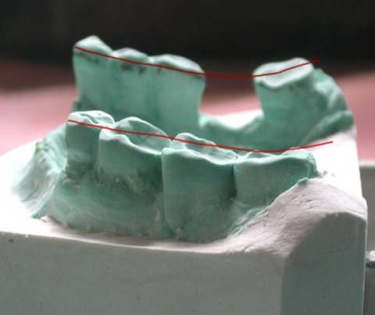

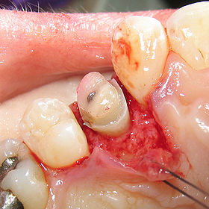
PLANE OF OCCLUSION
If alteration is required;
Selective occlusal adjustment
A fixed partial denture
Intentional De-vitalization
Clinical crown lengthening
Extraction
David Henderson; Occlusion in removal partial Prosthodontics. J Prosthet Dent 91:1-5; 2004

Slide 10
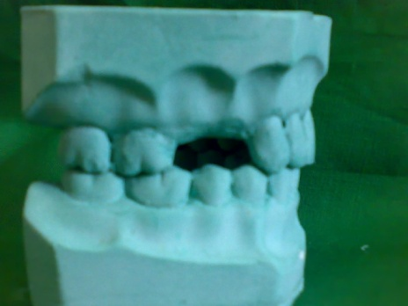
ESTABLISHING OCCLUSAL RELATIONSHIP
Five methods -
Direct opposition of casts :
When only a few teeth are to be replaced on short denture bases and there is no evidence of occlusal abnormalities
McCracken – Removable Partial Prosthodontics

Slide 11

Inter occlusal records with posterior teeth remaining.
When sufficient natural teeth remain to support the removable partial denture but the relation of opposing natural teeth does not permit the occluding of cast by hand.
McCracken – Removable Partial Prosthodontics

Slide 12
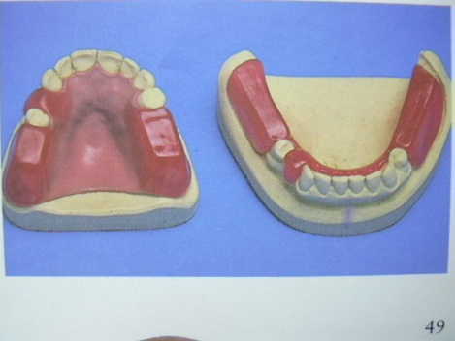
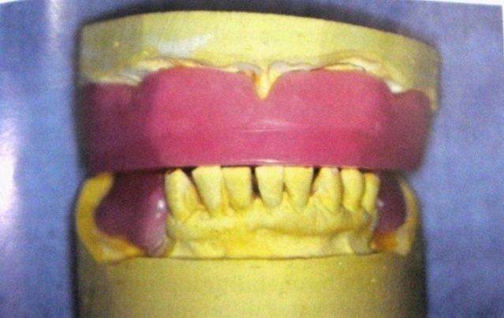
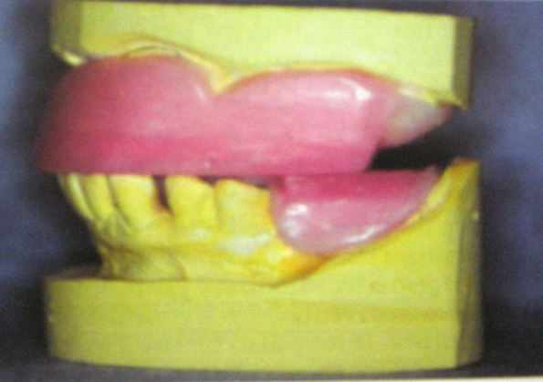
Occlusal relation using occlusal rims on record base.
  When one or more distal extension areas are present.
  When a tooth supported edentulous space is large .
  When opposing teeth do not meet.
McCracken – Removable Partial Prosthodontics

Slide 13
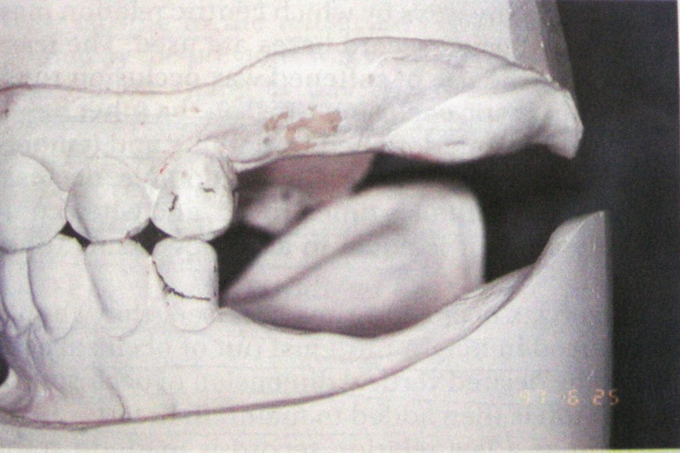
4. Jaw relation records made entirely on occlusal rims.
  When an opposing maxillary complete denture with a mandibular removable partial denture.
  Few remaining teeth do not occlude and will not influence eccentric jaw movements.
McCracken – Removable Partial Prosthodontics

Slide 14
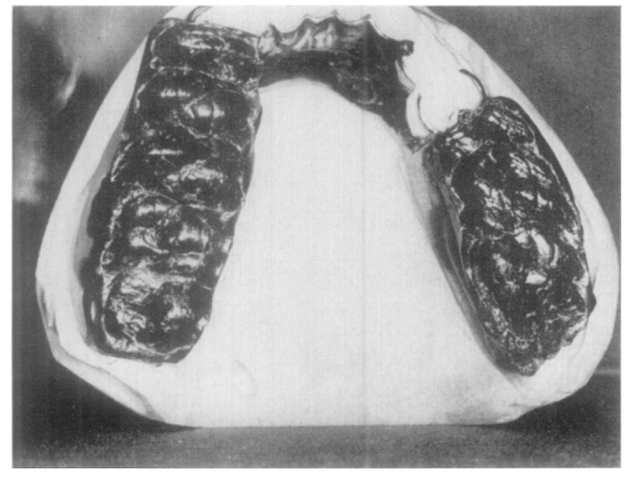
5. Establishing occlusion by recording of occlusal pathway
According to Thompson “Observing the occlusion with the teeth in static relation and then moving the mandible into various eccentric positions is not sufficient. A dynamic concept is necessary to produce an occlusion that is in functional harmony with facial skeleton , the musculature , and the TMJ ”
McCracken – Removable Partial Prosthodontics

Slide 15
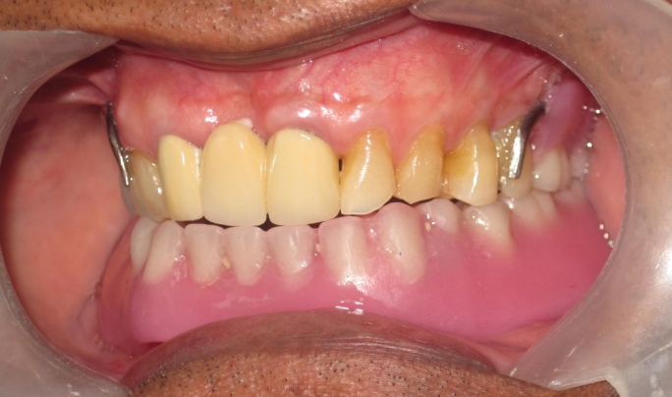
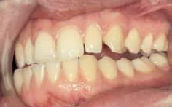
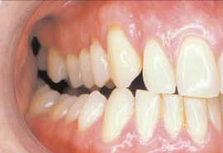
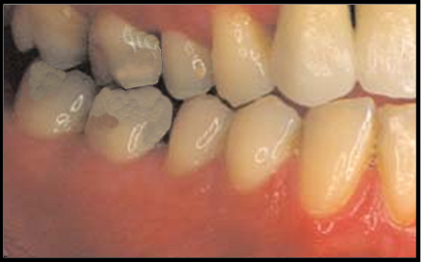
OCCLUSAL SCHEMES
Balanced occlusion
Mutually protected occlusion
Canine protected occlusion
Lingualized occlusion
Monoplane occlusion
David Henderson; Occlusion in removal partial Prosthodontics. J Prosthet Dent 91:1-5; 2004

Slide 16
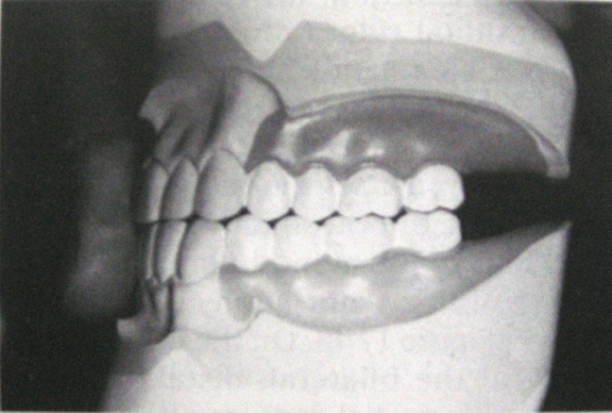
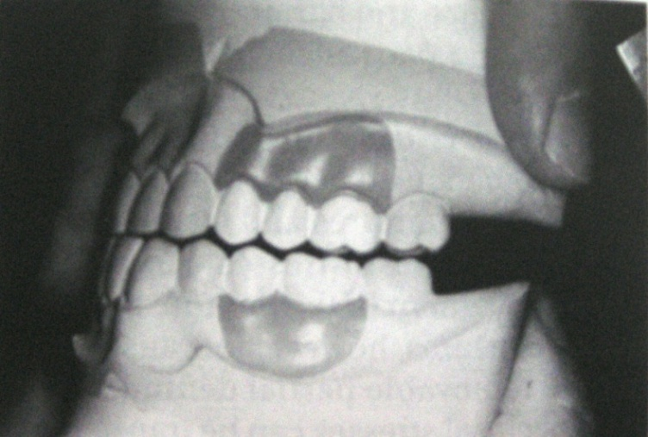
DESIRABLE OCCLUSAL CONTACT RELATIONSHIP FOR REMOVABLE PARTIAL DENTURES
Simultaneously bilateral contacts of posterior teeth in centric occlusion
Occlusion for tooth supported removable partial denture is arranged similar to occlusion seen in natural dentition
David Henderson; Occlusion in removal partial Prosthodontics. J Prosthet Dent 91:1-5; 2004

Slide 17
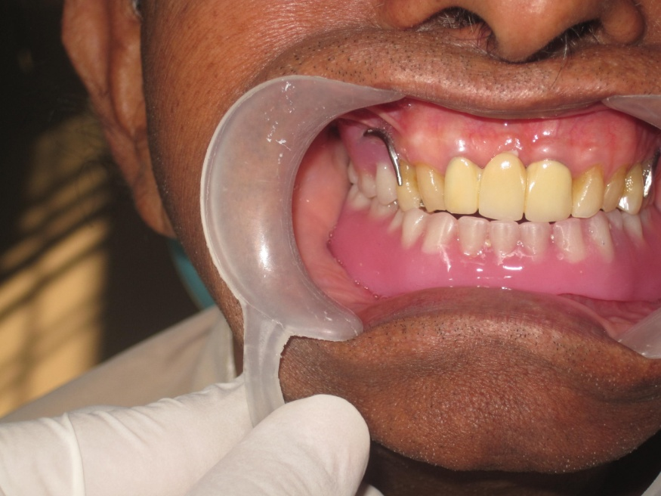

3. Maxillary complete denture opposing RPD: Bilateral balanced occlusion in eccentric position

Slide 18
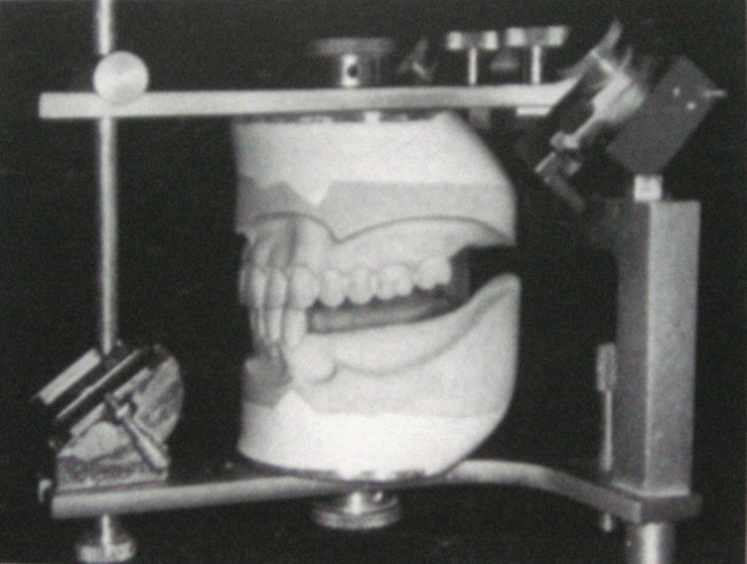
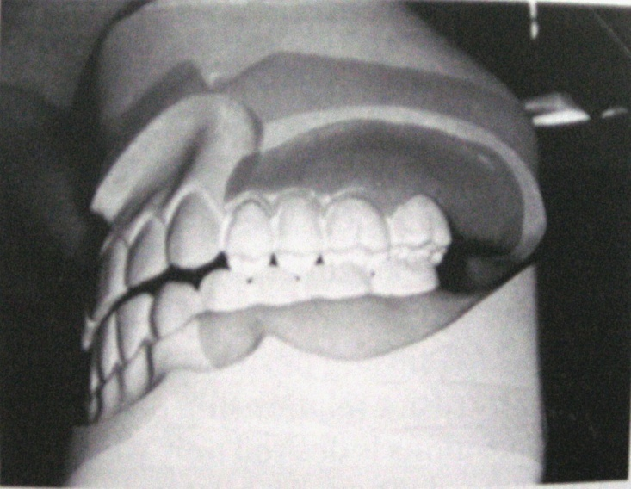
4. Mandibular distal extension denture:Working side contact.
5. Maxillary bilateral distal extension RPD: Simultaneous working and balancing contact
David Henderson; Occlusion in removal partial Prosthodontics. J Prosthet Dent 91:1-5; 2004

Slide 19
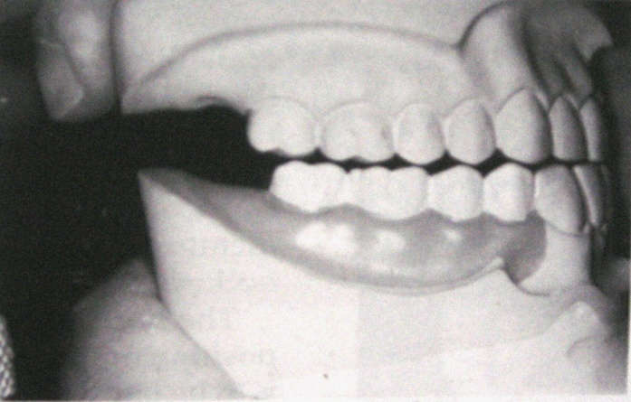
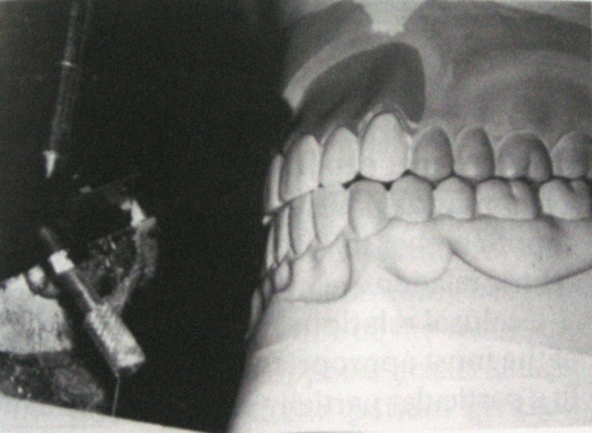
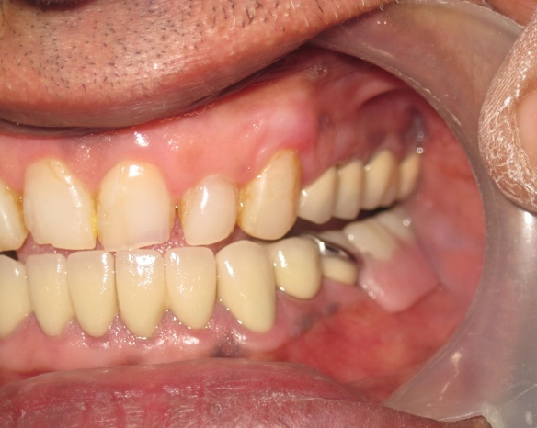
6. Maxillary or Mandibular unilateral distal extension removable partial dentures :Only working contacts .
7. In the Kennedy Class IV removable partial denture configuration contact of opposing anterior teeth in the planned intercuspal position should prevent a continuous eruption of the opposing natural incisors.
David Henderson; Occlusion in removal partial Prosthodontics. J Prosthet Dent 91:1-5; 2004

Slide 20
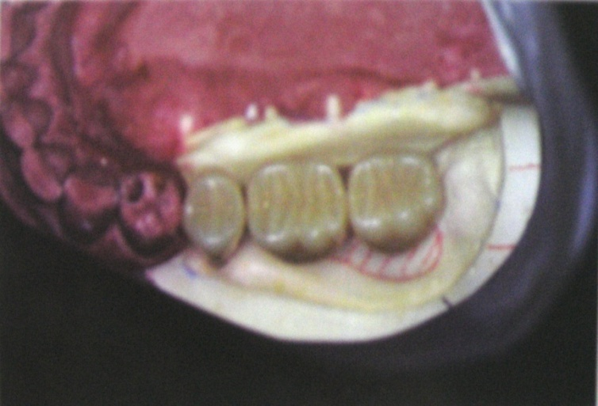
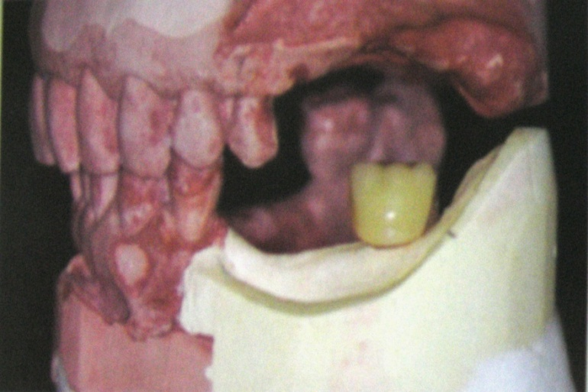
8. Opposing CD or bilateral distal extension maxillary RPD :Balanced contact in a protrusive relationship and excursive position .
9. Artificial posterior teeth should not be arranged further distally than the beginning of an upward incline of the mandibular residual ridge or over the retromolar pad.
David Henderson; Occlusion in removal partial Prosthodontics. J Prosthet Dent 91:1-5; 2004

Slide 21
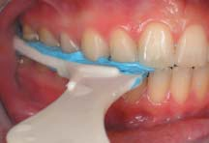
INTEROCCLUSAL RELATION RECORD
Made in either the centric relation or maximum intercuspation position at the correct vertical dimension of occlusion
Allow accurate and positive alignment of the casts
Dimensionally stable
Made with a soft material to minimize the displacement of tissues
Easily used by both the clinician and the technician
William McCracken; Functional occlusion in removable partial denture construction. J Prosthet Dent 8:955; 1958

Slide 22
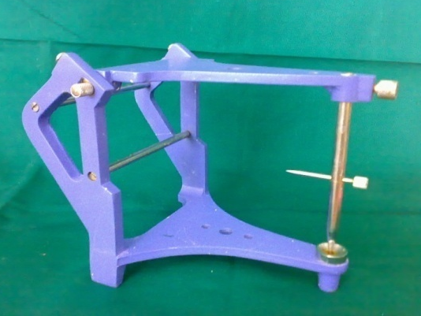
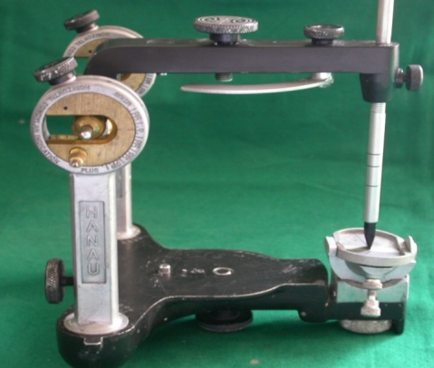
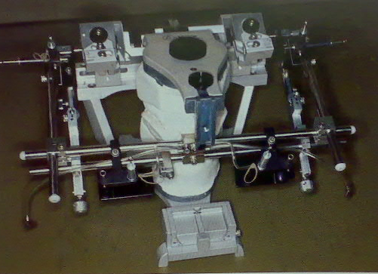
CHOICE OF AN ARTICULATOR
Used to :
  Relate casts in static positions to the condyles
  To simulate paths of mandibular movements.
Choice depends on :
  Complexity of the treatment.
  Requirements dictated by patient’s current condition.
John Ivanhoe, Kevin Plummer; Removable partial denture occlusion. DCNA 48:667; 2004

Slide 23
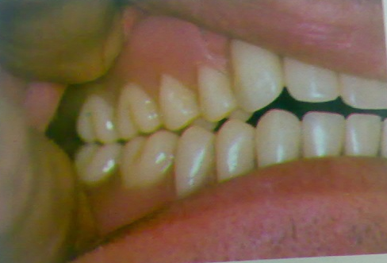
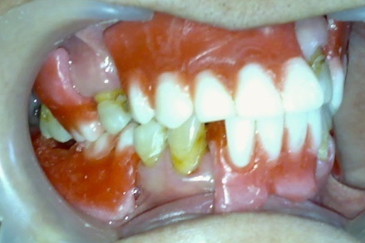
CENTRIC RELATION OR CENTRIC OCCLUSION?
If natural posterior teeth in one arch are able to provide occlusion with tooth supported RPD.
- centric occlusion
2. In cases where few posterior teeth and one or more extension bases are present.
- centric occlusion
Albert Colman; Occlusal requirements for removal partial dentures. J Prosthet Dent 17:155; 1967

Slide 24
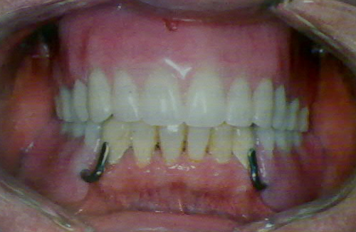
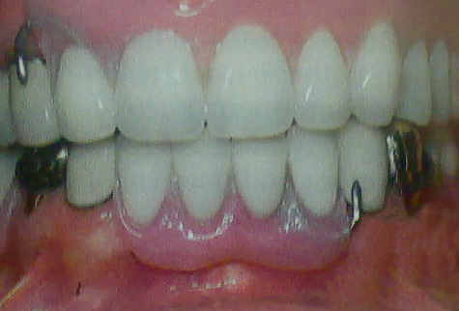
In case only anterior teeth remains: centric relation
In cases where complete denture is present opposite to tooth supported or extension base RPD – Bilateral balanced occlusion and centric relation.
In anterior extension RPD – Centric occlusion.
Albert Colman; Occlusal requirements for removal partial dentures. J Prosthet Dent 17:155; 1967

Slide 25
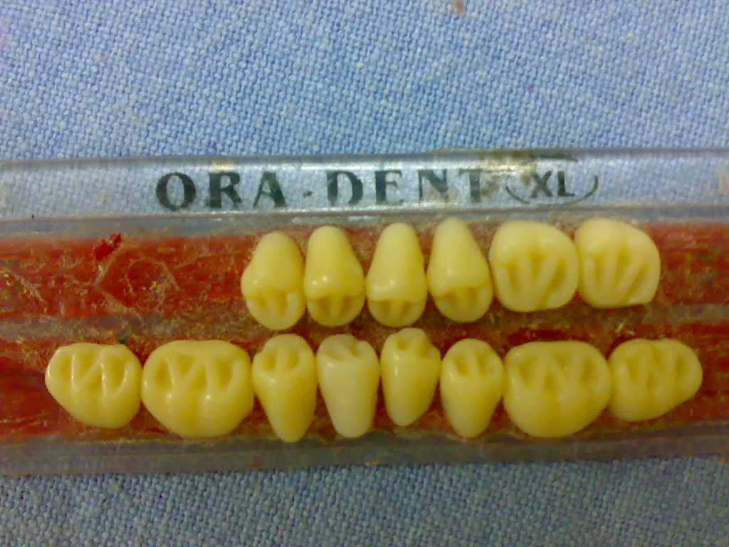
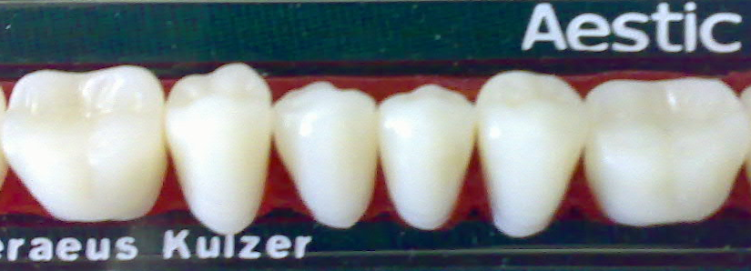
ARTIFICIAL TEETH
FORMS
Monoplane form
Semi-anatomic form
Anatomic form
MATERIALS
Acrylic teeth
Porcelain teeth
Cast gold occlusal surface
Cast ceramic surface.

Slide 26

DETERMINING OCCLUSAL SCHEME
KENNEDY’S CLASS I
Balanced articulation is recommended for patients
for increased denture stability.
John Ivanhoe, Kevin Plummer; Removable partial denture occlusion. DCNA 48:667; 2004

Slide 27
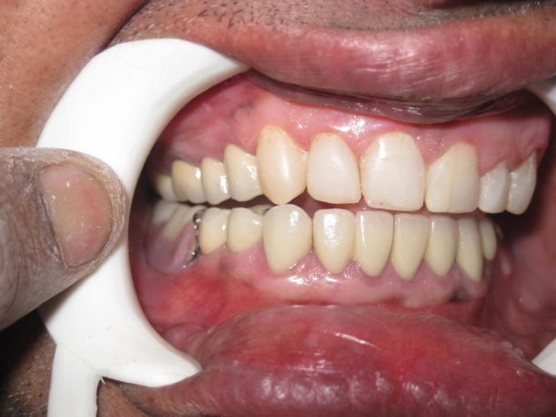
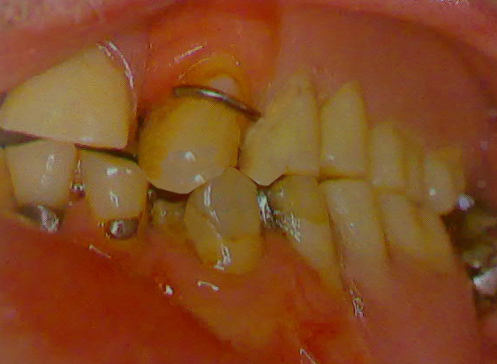
KENNEDY CLASS II
Canine-protected articulation reduces the destructive lateral forces.
Except when opposing a complete denture, a balanced articulation should be avoided to prevent nonworking contacts on natural teeth.
John Ivanhoe, Kevin Plummer; Removable partial denture occlusion. DCNA 48:667; 2004

Slide 28

KENNEDY CLASS III
Occlusal morphology of artificial teeth is same as opposing teeth.
Existing occlusal scheme is followed.
A group function articulation is recommended if the natural canine is missing or periodontally compromised.
Balanced occlusion when opposing a complete denture.
John Ivanhoe, Kevin Plummer; Removable partial denture occlusion. DCNA 48:667; 2004

Slide 29
KENNEDY CLASS IV
During excursive movements an anterior artificial tooth should either disocclude or have a passive contact.
Balanced occlusion when opposing complete denture.
John Ivanhoe, Kevin Plummer; Removable partial denture occlusion. DCNA 48:667; 2004

Slide 30
To Summarize…
Natural posterior teeth present – Existing occlusal scheme
Opposing complete denture – Bilateral balance
Unilateral distal extension – Working side contact
Bilateral distal extension – Balancing and Working contact

Slide 31
CONCLUSION
No single occlusal morphology, scheme or material will successfully treat all patients.
Skills in diagnosis and treatment planning are of utmost importance in treating patients, for whom the clinician’s goal is not only an esthetic and functional restoration but also a lasting harmonious state.

Slide 32


