Slide 1
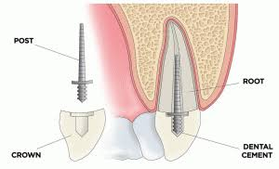
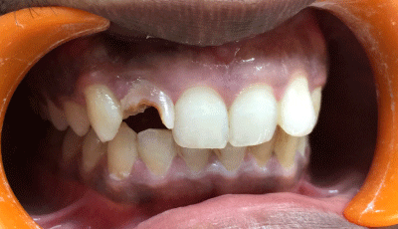
Restoration of endodontically treated teeth

Slide 2
Principles of Restoration of Endodontically Treated Teeth
Provide good coronal seal.
Protect/conserve remaining tooth structure.
Satisfy functional and aesthetic needs.
Reduction of stresses with favourable distribution within remaining tooth structure.

Slide 3
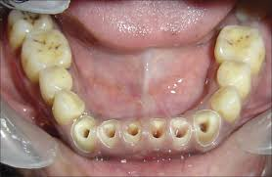
Treatment options
Anterior teeth
1. Intact coronal tooth structure except for prepared access opening—access opening is restored with composite resin if no discolouration is present.
2. Less than 25% coronal tooth structure is damaged—a complete coverage crown is required.
3. More than 25% coronal tooth structure is damaged—a post and core with crown is required.

Slide 4
Treatment options
Posterior teeth
1. Less than 50% coronal tooth structure is
damaged— core and crown required.
2. More than 50% coronal tooth structure is
damaged— post, core and crown is required.

Slide 5
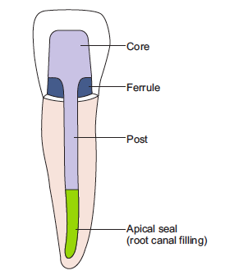
POST
It is that part of the prosthesis usually made of metal that is fitted into a prepared canal of a natural tooth.
The basic purpose of a post is to retain a core.

Slide 6
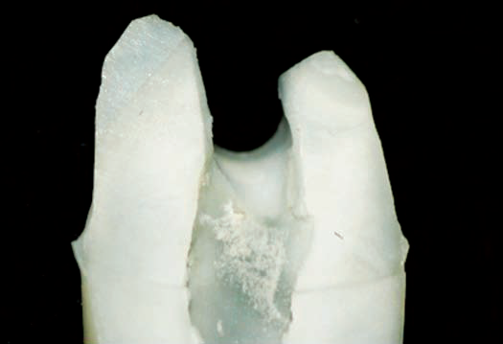
Rationale for the Use of Post
Decreased moisture content.
Subsequent brittleness of pulpless teeth.
Loss of both internal and external tooth structure
Unrestored teeth less resistant to stress and an undesirable abutment.

Slide 7
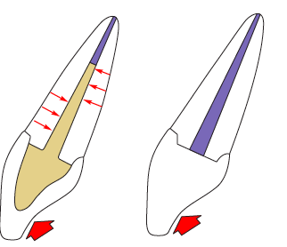
Rationale for the Use of Post
Increase the resistance to horizontal and vertical forces
Coverage of the entire occlusal surface of the tooth with a restoration reduces the incidence of vertical fracture.
Internal reinforcement using the residual root for anchorage will resist horizontal fractures.

Slide 8
IDEAL REQUIREMENTS
Maximal retentiveness of the core, with minimal removal of dentine.
Physical properties compatible to dentine, and with core material.
Even distribution of functional forces along the root surface.
Aesthetic compatibility with the definitive restoration and surrounding tissue.
Minimal stress during placement and cementation.
Resistance to displacement yet easy retrievability.
Ease of use, safety and reliability.
Reasonable cost.

Slide 9
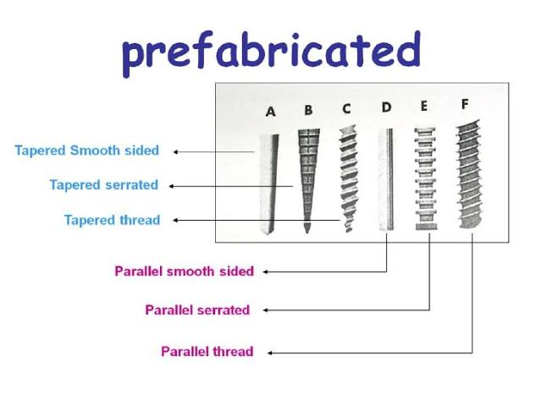
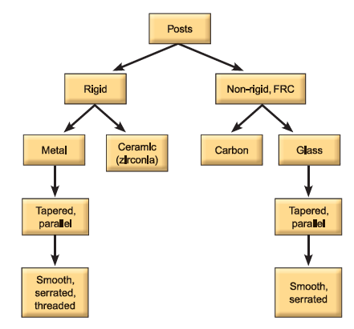
CLASSIFICATION

Slide 10
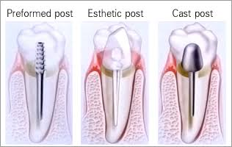
Classification
Shape —parallel, tapered
Stiffness —rigid, non-rigid
Surface —smooth, serrated, threaded
Colour —aesthetic, non-aesthetic
Pressure on root —active, passive
Fabrication —prefabricated, custom-made (cast posts).

Slide 11
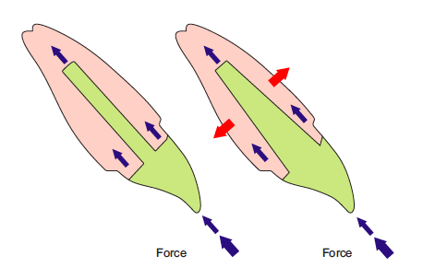
Parallel and Tapered Posts
Parallel-sided posts direct the occlusal forces apically while tapered posts direct the forces laterally by producing a wedging effect. Hence, occlusal forces are better directed by parallel posts. They are also more retentive than tapered posts.
Tapered posts are more conservative of tooth structure

Slide 12
NON RIGID POSTS
Made of glass, quartz or carbon fibres embedded in a resin matrix, also called ‘fibre-reinforced composite’ posts (FRC).
They have to be adhesively bonded to the root canal space.
Can reinforce weak teeth with flared canals.
Require less preparation—preserve integrity and strength of dentine.
Less root fracture.
Indicated in teeth with more than 25% remaining tooth structure.

Slide 13
Rigid and Non-rigid
If a post has higher rigidity than anchoring material (dentine), stress is transmitted adjacent to the bottom of post, which can cause root fracture. On the other hand, a Flexible post can distort and open crown margins.
Hence, the post should be resilient enough to cushion an impact and strong enough to resist permanent deformation.

Slide 14
RIGID POSTS
Can be made of crown and bridge alloys (cast posts), stainless steel, titanium, zirconia (prefabricated posts).
Zirconia has greatest stiffness followed by steel and titanium alloy.
More chance of root fracture than non-rigid.
Indicated for teeth with less than 3–4 mm vertical height or less than 25% tooth remains.

Slide 15
Smooth, Serrated, Threaded Posts
Smooth posts provide least retention, but are passive (no force transmitted to tooth).
Serrated posts provide better retention and are also passive.
Threaded posts provide best retention, but are active, hence, root fractures may occur.

Slide 16
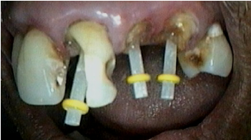
Aesthetic and Non-aesthetic Posts
Metal posts are non-aesthetic, as they may reflect through an all-ceramic crown
Zirconia posts and fibre-reinforced composite posts are called aesthetic posts. They are indicated for use with all-ceramic restorations.
The glass fibre posts can also be used to reinforce the root surface in case of excessively large canal space.

Slide 17
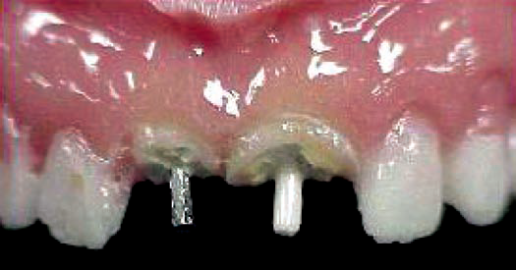
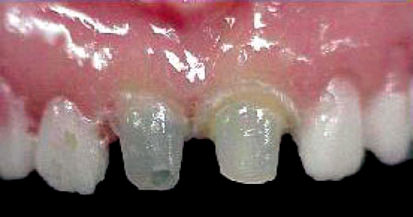
Prefabricated metal (unaesthetic) post on 11 and fibre post (aesthetic) on 12
Metal seen through following core build-up

Slide 18
Active and Passive
All threaded posts are active as they exert pressure on the root.
Smooth and serrated posts are passive.

Slide 19
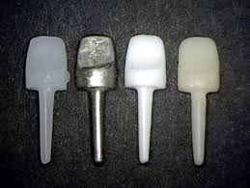
Custom-made and Prefabricated Posts
The only custom-made post is the ‘cast post’
It is also called as ‘one-piece’ post, as the post and core are not separable.
The use of this post is declining.

Slide 20
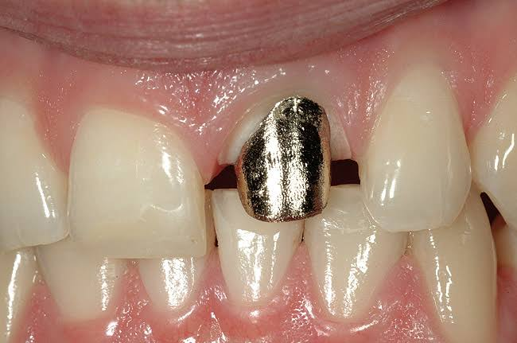
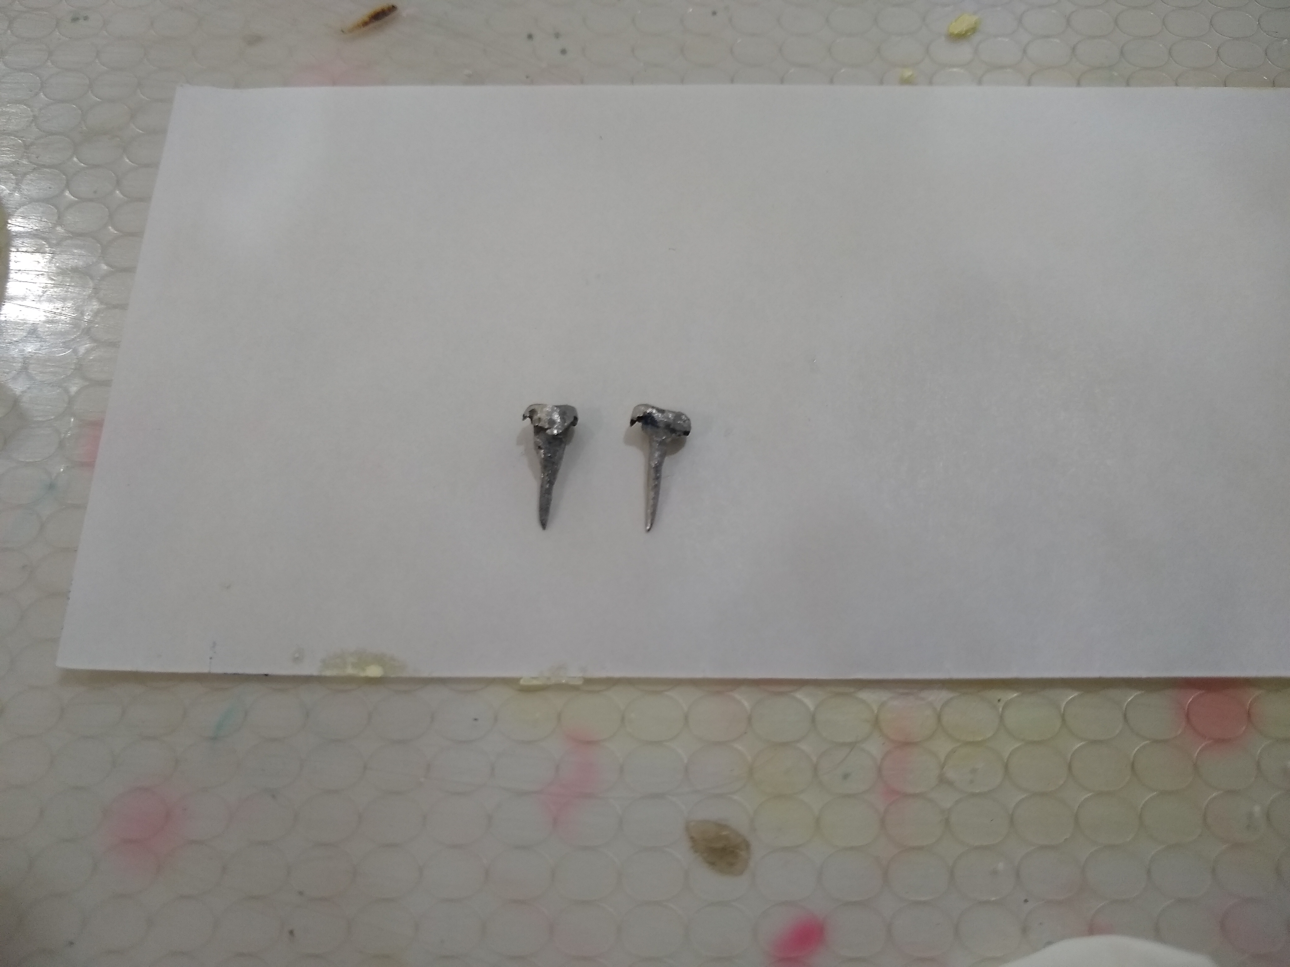
Cast post and core
A one-piece foundation restoration for an endodontically treated tooth that comprises a post within the root canal and a core replacing missing coronal structure to form the tooth preparation (GPT8).
Advantages
- Conservative of tooth structure.
- High strength.

Slide 21
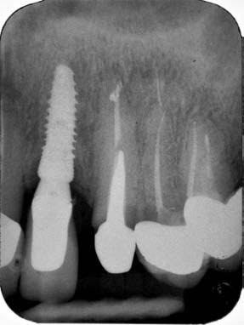
Disadvantages
Time—requires two appointments.
Wedging effect—because they can only be made tapering and high rigidity.
Porosity—problem and casting procedure.
Fit—may not be very accurate because of indirect method.
Unaesthetic—as it can be made only of crown and bridge alloys. Hence, it cannot be used with all-ceramic restorations.
Cost—lab costs will be incurred

Slide 22
PREFABRICATED POST
Versatile.
Available in different configurations and can be selected as per the given clinical situation.
Available in different diameters corresponding to the size of the drill. Hence, the fit is accurate

Slide 23
SELECTION OF POST
Length
Diameter
Shape
Surface configuration
Location.

Slide 24
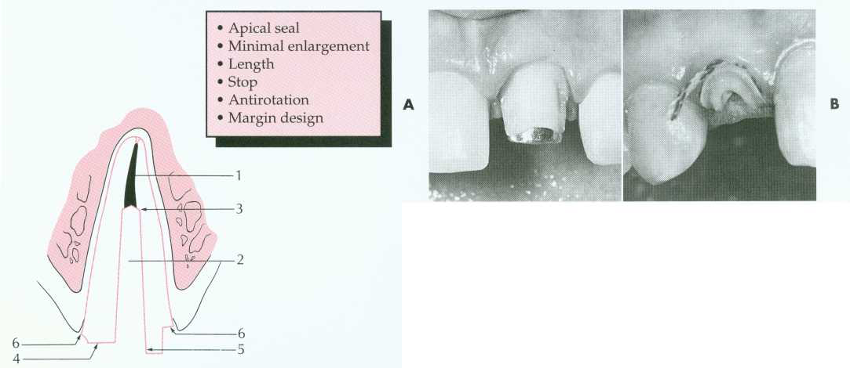
LENGTH
Important for retention
Should be as long as possible without compromising the apical seal and strength or integrity of remaining root structure
Equal to half the remaining length of the tooth.
Equal to two-third the root length of the root.
Half the length of root contained in bone.
Have minimum of 4 mm of gutta percha apically to provide adequate seal.

Slide 25
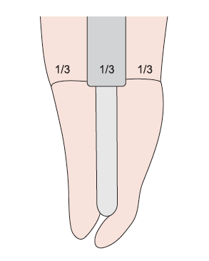
DIAMETER
Resistance to fracture is directly related to the remaining root structure. Hence, the diameter of post:
Should not exceed one-third the mesiodistal root diameter.

Slide 26
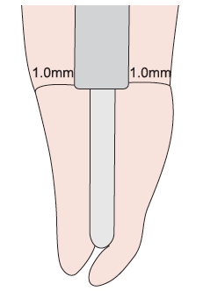
At least 1 mm of dentine should surround the preparation
Minimal preparation of root canal limited to removal of undercuts has also been advocated

Slide 27
SHAPE
Parallel-sided posts are preferred as they have better retention and more favourable stress distribution.
Tapered posts are indicated for the significantly tapered canal system.

Slide 28
Surface Configuration
Parallel-sided serrated posts are generally indicated.
If root length is less, threaded posts offer better retention.

Slide 29
LOCATION
Posts should be placed in roots that are round straight and long.
In the anterior teeth, roots are seen mostly with circular cross-section.
Root anatomy of multirooted teeth is most suitable in the palatal roots of maxillary molars, palatal roots of maxillary premolars, and distal roots of mandibular molars

Slide 30
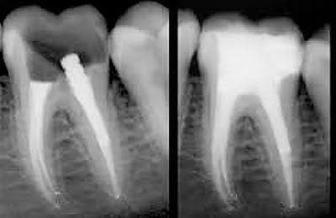
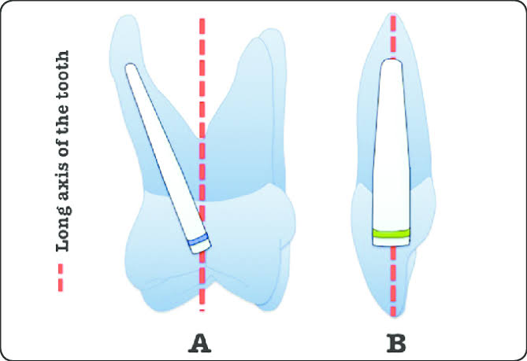

Slide 31
TOOTH PREPARATION

Slide 32
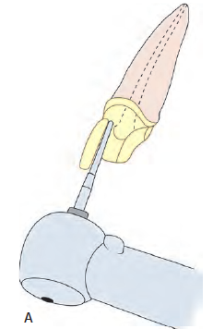
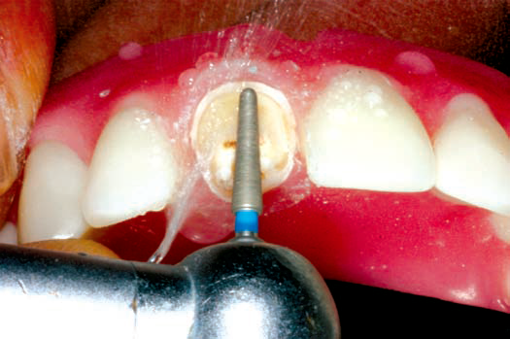
Preparation of Coronal Tooth Structure
Coronal tooth structure is prepared according to the type of extracoronal restoration planned.

Slide 33
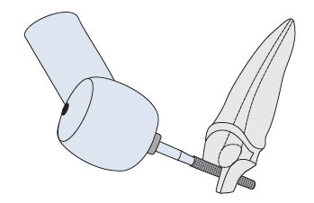
All existing caries, restorations, cements, bases and unsupported tooth structures are removed
Preserve as much of intact coronal tooth structure as possible to externally brace the tooth.

Slide 34
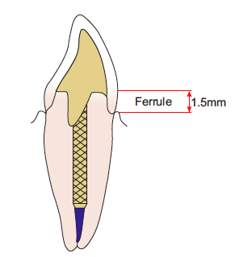
FERRULE
Minimum of 1.5 mm of sound tooth structure 360° around the tooth should be present, apical to the core. It improves structural integrity of the tooth and prevents fracture

Slide 35
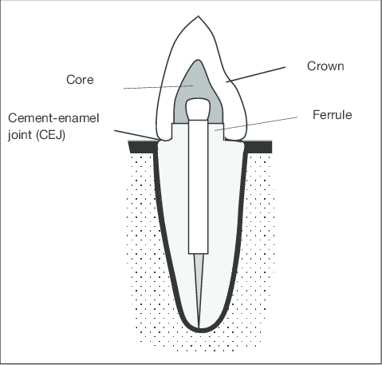
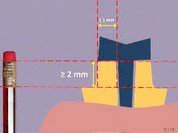
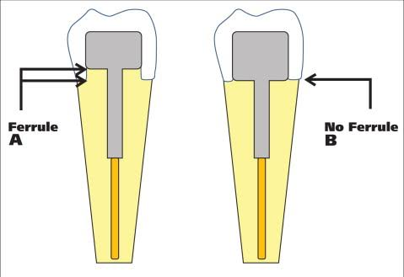

Slide 36
Preparation of Post Space
Peeso reamers and Gates Glidden drills are used to remove the gutta-percha as they are safe-sided instruments as they are not end-cutting. They come in different sizes according to diameter

Slide 37
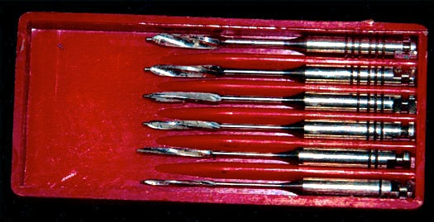
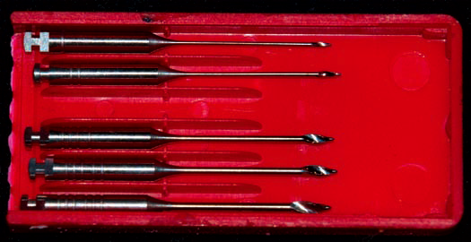
P
E
E
S
O
G
A
T
E
S

Slide 38
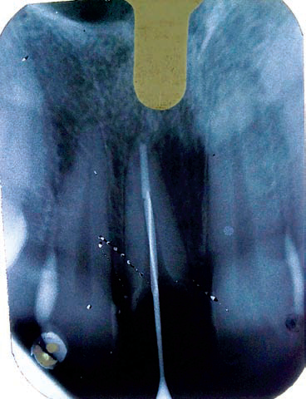
Appropriate length and diameter of the post are determined using a radiograph as a guide and following the guidelines

Slide 39
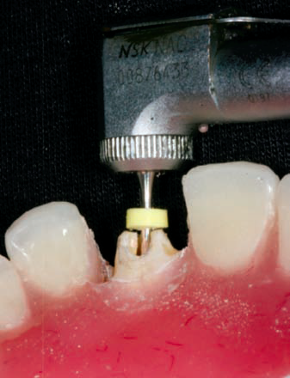
An endodontic stopper is placed in the shank of reamer or drill to ensure appropriate length.

Slide 40
The procedure is begun with the smallest Peeso or Gates that will fit into the canal.
Once the root filling is removed, successively larger Peeso or Gates is used to enlarge the canal to desired dimensions.

Slide 41
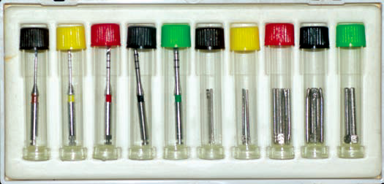
Some prefabricated post systems are provided with specific drills corresponding to the diameter of the posts
These drills are used to enlarge the canals to the required diameter, when available.

Slide 42
Rosensteil…

Slide 43
Custom-made Posts (Cast Posts)
Custom-made posts are categorized as—rigid, metal, tapered, smooth, in the classification for posts
They can be fabricated:
1. Directly
2. Indirectly

Slide 44
Direct Method
A pattern of the post and core is fabricated directly in the patient’s mouth and then cast in the laboratory.
Disadvantages
Consumes a lot of clinical time.
Any problem in casting, procedure has to be repeated intraorally.

Slide 45
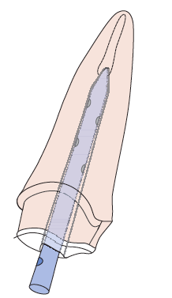
A 14-gauge plastic sprue (a plastic tooth pick or stainless steel wire can also be used) is trimmed to check the fit in canal.
Grooves are cut on the surface for retention of the pattern material.
A mark or notch is made facially to allow re-orientation subsequently

Slide 46
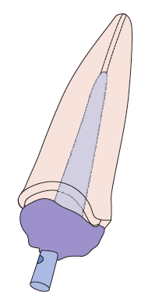
Canal and surrounding areas are lubricated with petroleum jelly.
Autopolymerizing acrylic resin is mixed to a running consistency, coated on sprue and inserted in the canal

Slide 47
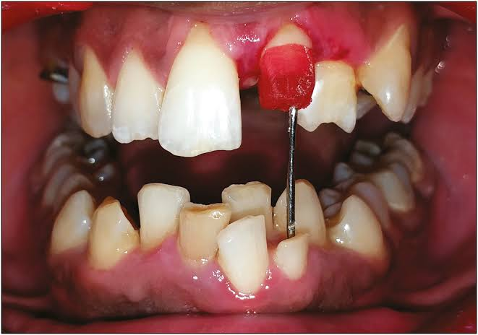
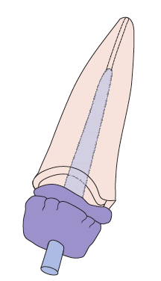
After the resin in the post portion sets, the core is built up with the same material and moulded with fingers

Slide 48
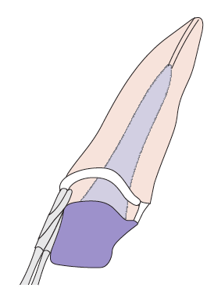
After setting, it is prepared to the appropriate shape of core

Slide 49
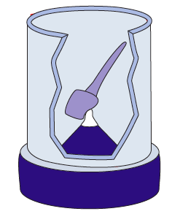
The pattern is then sprued, invested and cast in designated crown and bridge alloy.

Slide 50
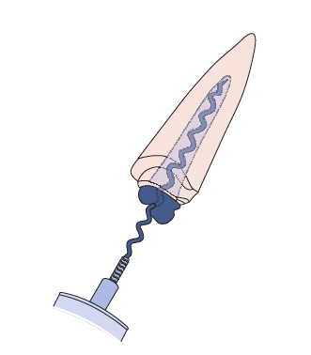
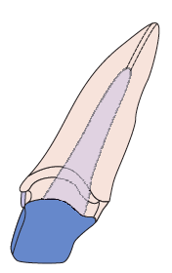
The luting cement is coated in the canal space using lentulo spiral
The cast post and core is then cemented using conventional Definitive cements

Slide 51
Indirect Method
An impression is made of the canal space using a putty and light body wash, and the pattern is fabricated indirectly on a model and cast
Indicated for multiple posts and posts in multirooted teeth
Adv:There is less usage of chairside time and as a cast is available, any problems in casting can be easily repeated

Slide 52
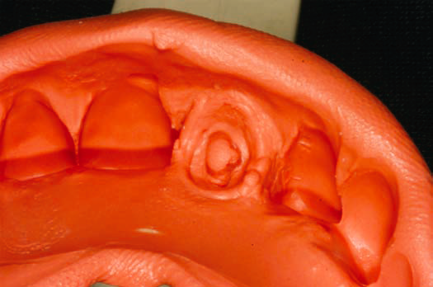
Putty impression is made of prepared tooth along with the entire arch.

Slide 53
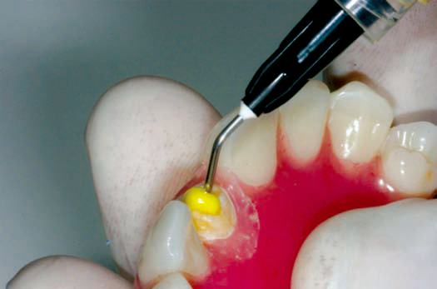
Light body material injected into post space and placed on the putty impression after creating adequate space – a second impression is made

Slide 54
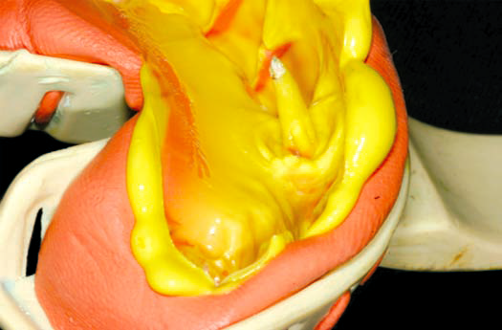
Following removal of final impression – cast can be poured where the post can be fabricated.

Slide 55
PREFABRICATED POSTS

Slide 56
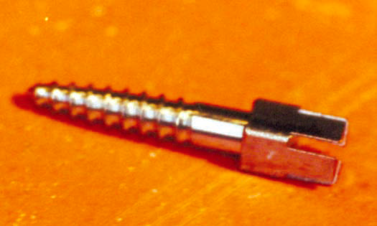
Rigid-metal-tapered-threaded (Dentatus post)

Slide 57
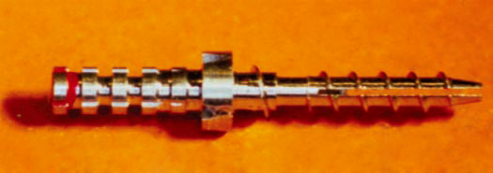
Rigid-metal-parallel-threaded (Flexi-Post)

Slide 58
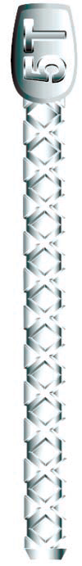
Rigid-metal-parallel-serrated (ParaPost)

Slide 59
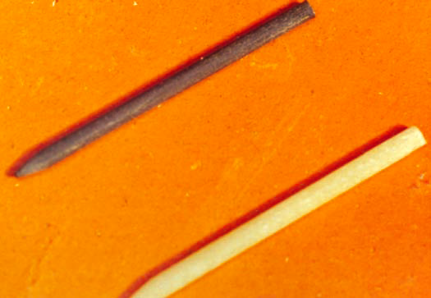
Non-rigid carbon (Mirafit posteriors)—quartz coated
(right) for anteriors

Slide 60

Non-rigid-glass fibre reinforced-tapered-smooth post

Slide 61
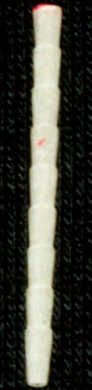
Non-rigid-glass fibre reinforced-parallel-serrated post
(Parapost fibrelux)

Slide 62
PROCEDURE

Slide 63

Threaded post (metal-tapered-threaded post—Dentatus)
Available in sizes 1–6 (according to diameter) and length – short, medium, long
Assorted kit of threaded posts in varying
sizes and lengths with drivers.

Slide 64

A radiograph is used to determine the length and diameter as per the guidelines

Slide 65
According to the size, the canal is prepared with Peeso reamers or Gates drills, with a rubber stopper to achieve appropriate length.
The final size of drilling is:
one more than post size while using Peeso reamer and
two more than the post size while using Gates
glidden

Slide 66

If post size selected is 4, the final Peeso used for drilling should be size 5, and Gates should be size 6

Slide 67

The selected post held with a driver is screwed into the canal.

Slide 68

^{Final placement}

Slide 69

A core is then built up with appropriate material

Slide 70
Parallel post (metal-parallel-serrated post-Parapost)
They are available in various sizes and drills to match the post diameters. The desired length can be cut from the apical end.

Slide 71

As before, the Peeso reamers or Gates drills are used to remove the gutta-percha with a rubber stopper for length. The drills provided in the kit are used to enlarge the
canal to the selected diameter of post

Slide 72

The post corresponding to the final drill is selected and tried in the canal space

Slide 73

If length is too long, it is cut from the apical end

Slide 74


Cement mixed and placed in canal with a lentulo spiral.
^{Post coated with cement}

Slide 75

^{Post inserted in canal}

Slide 76

Core built up with composite resin.

Slide 77
Aesthetic Post (Non-rigid, Glass, Tapered, Serrated –
ParaPost Taperlux)
^{Used with all-ceramic crowns.}
They are bonded to the tooth using adhesive cements

Slide 78

^{Gutta-percha removed}
^{with Gates drill.}

Slide 79

^{Canal enlarged to appropriate}
^{size with corresponding drills}

Slide 80

^{Post tried-in.}

Slide 81

^{Canal space etched}
^{with phosphoric acid.}

Slide 82

^{Bonding agent}
^{is applied, but not cured.}

Slide 83

Dual-cure resin cement is mixed and placed in canal.
The post is also coated with the cement

Slide 84

The post is inserted in canal and light-cured.

Slide 85

A core is built-up with composite resin.

Slide 86

Provisional restoration fabricated.

Slide 87
Post Cementation
Retention of post to the root canal depends on:
Post—material, length and surface texture
Amount of remaining tooth structure
Cement.

Slide 88
Cements Used
Zinc phosphate cement
Glass ionomer cement
Resin cement

Slide 89

ZINC PHOSPHATE

Slide 90

GLASS IONOMERS

Slide 91

RESIN CEMENTS

Slide 92
Selection of cement
The type of cement used has little effect on retention or fracture resistance in teeth with adequate tooth structure.
Resin cements improve the performance of posts with improved retention.
Resin cements indicated for FRC posts.

Slide 93
CORES

Slide 94
IDEAL REQUIREMENTS
Easy to use
High compressive strength
Easy to manipulate
Short setting time
Good dimensional stability
Less microleakage
Ability to bond to tooth and post.

Slide 95
MATERIALS
Cast core
Amalgam
Glass ionomers
Composite resin.

Slide 96
CAST CORES
Used with cast post and as it is cast along with post there is no chance of core separating from post.

Slide 97

AMALGAM

Slide 98
GLASS IONOMERS
Low strength, brittle but anticariogenic.
Used for small build-ups especially in posterior teeth where significant sound dentine remains.
Resin-modified GIC better, used for moderate build ups, but not with all-ceramic crowns.

Slide 99
COMPOSITE RESINS
Adhesive bonding, ease of manipulation, rapid set, translucent or opaque, good compressive strength.
Better protection for teeth with metal posts from fracture compared to amalgam and GIC.

Slide 100
RETENTION OF POST TO CORE
Extremely critical for restoration survival.
Important criteria with prefabricated posts, not a problem with cast post and core.
May be adhesive and/or mechanical.
Posts with mechanical interlocking feature in the heads and roughened texture provide better retention.
Fiber and zirconia posts chemically bond to composite core materials.

Slide 101
POST CROWN
This is a one-piece post crown. It is also called as ‘ Richmond crown’
Indicated in patients with deep incisal overbite where it is difficult to provide space for a core and crown separately.

Slide 102

Fractured maxillary central incisor (tooth no: 11) with lack of occlusal clearance.

Slide 103

^{Coronal tooth preparation}

Slide 104

^{Preparation of canal space.}

Slide 105

Post crown fabricated by indirect method

Slide 106

^{Cemented post crown.}

