Slide 1
Vertical and Horizontal Jaw relations in complete denture
Dr. Piyush Mankar

Slide 2
JAW RELATION
It is defined as “Any relation of the mandible to the maxilla” or any spatial relationship of the maxillae to the mandible
Types: 1. Orientation jaw relation
2. Vertical jaw relation
3. Horizontal jaw relation

Slide 3

Competition
Classification of the jaw relation
Arbitrary
Orientation jaw relation
The competitive landscape
  Provide an overview of product competitors, their strengths and weaknesses
  Position each competitor’s product against new product
Actual
At rest
A
B
Vertical jaw relation
Price
At occlusal
D
C
Horizontal jaw relation
Centric
Performance
Eccentric

Slide 4
Record bases and occlusal rims
They simulate teeth and help in establishing vertical dimension and centric relation
Record bases should be retentive
  For making phonetics test and for accurate jaw relation record
If slightly loose, denture adhesive can be used
If pronounced looseness… final impression has to be remade

Slide 5
Causes for poor retention of record base
Poor adaptation of resin to cast
Over or under extension of borders
Excessive block out for undercuts while fabricating record base

Slide 6
Arbitrary adjustment of occlusal rims
Maxillary occlusal rim anterior height 22 mm
Mandibular occlusal rim anterior height 18mm
Maxillary rim slightly facial to ridge to compensate for residual ridge resorption and to support upper lip
Posteriorly the mandibular occlusal rim is kept upto 2/3rd of retromolar pad.

Slide 7
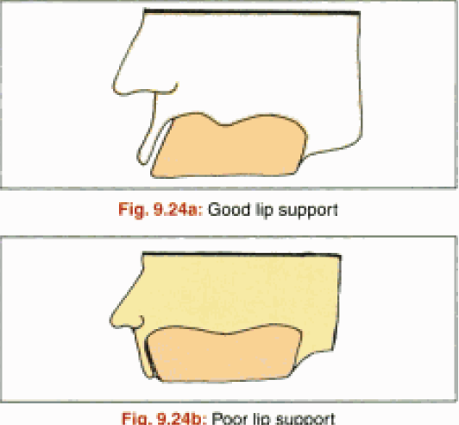
Recording Vertical Jaw Relation
1)Properly contoured maxillary occlusal rim is inserted in the patient’s mouth and following are assessed
  Lip support: Upper lip should just supported enough.
  Visibility of the rim: at rest 0.5 – 1.0 mm of the rim should be visible
2)Touches wet line of lower lip when pt says F or V sounds
  Ask patient to Count from 50 -60
3)Lips relaxed
4)Naso labial angle should be at 90 degree
5)Philtrum should be depressed slightly, There should be no obliteration or stretching of philtrum

Slide 8
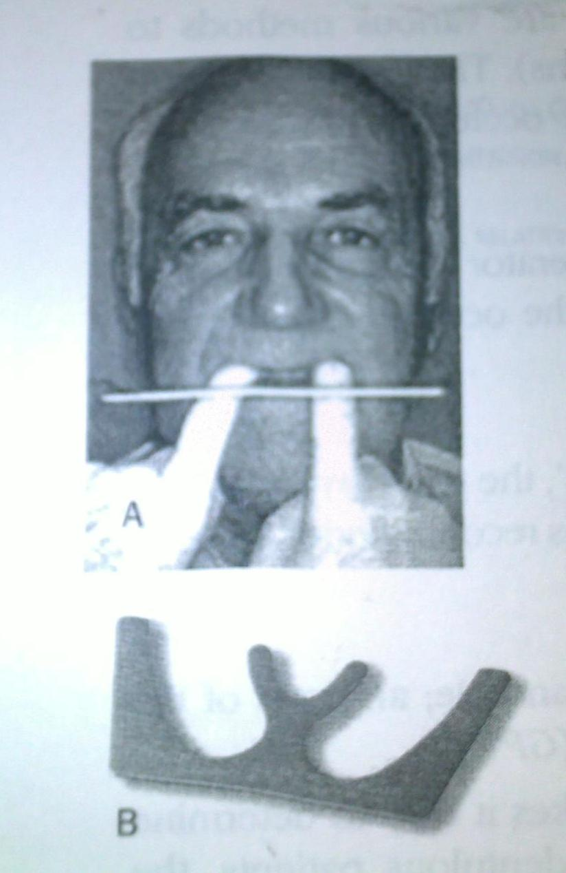
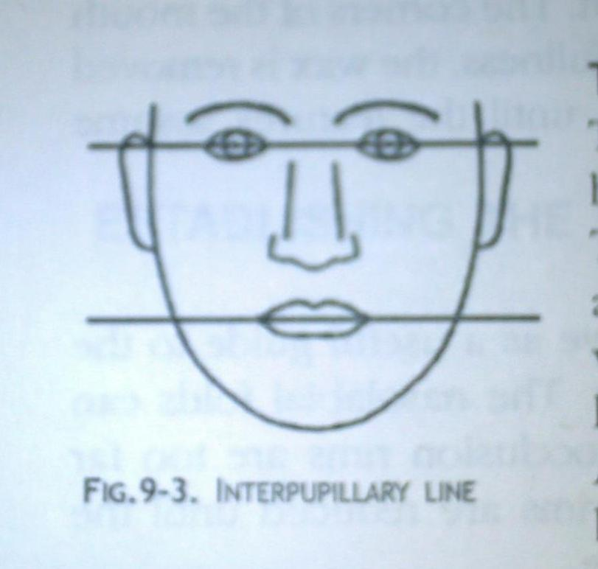
Orientation of occlusal plane
Anteriorly the maxillary occlusal plane is adjusted to be parallel to interpupillary line.
Done using fox plane

Slide 9
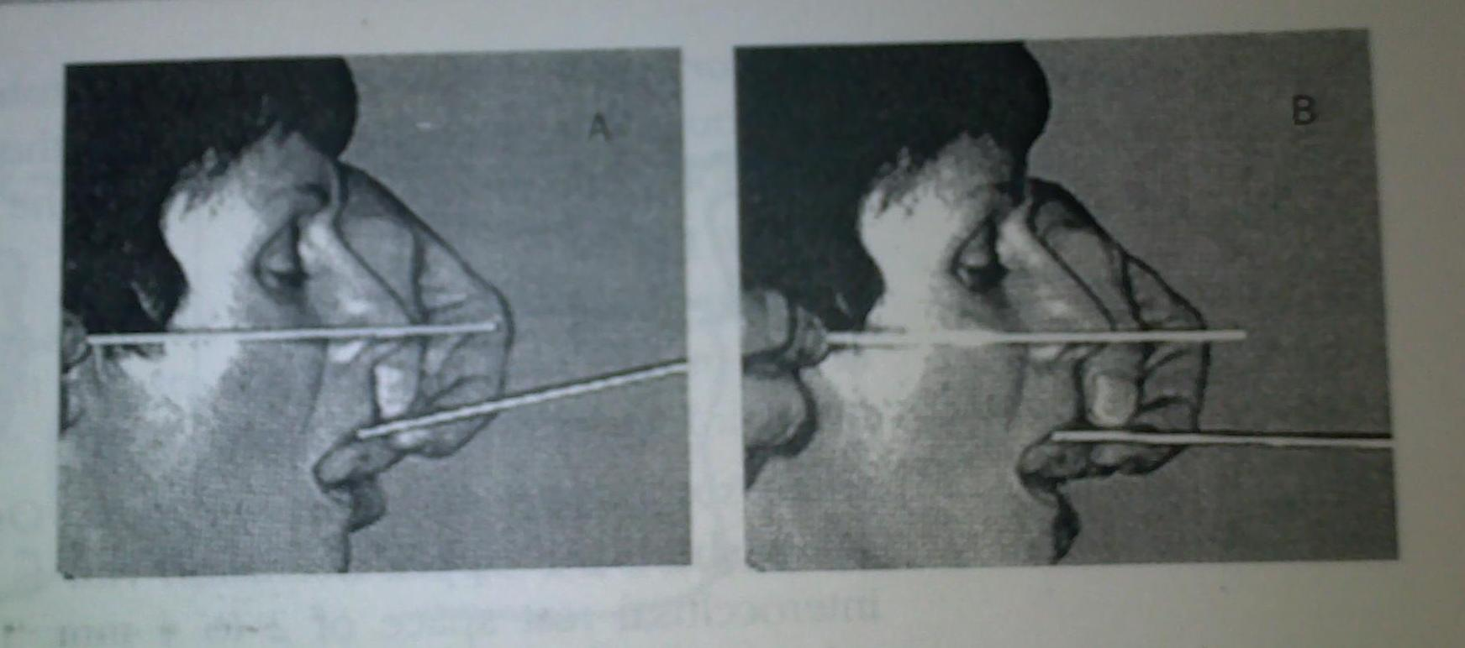
Posteriorly the occlusal plane is adjusted to be parallel to ala-tragus line(camper’s plane)
Camper’s plane: a plane established by the inferior border of the ala of the nose (or the average between the two) and the superior border of the tragus of each ear

Slide 10
For mandibular occlusal rim
  Anteriorly the occlusal plane should be at the corner of the mouth
  Posteriorly the occlusal rim should be at the junction of anterior 2/3rd and posterior 1/3rd of the retromolar pad.

Slide 11
3 components
Physiologic rest position / rest vertical dimension (RVD)
Occlusal vertical dimension (OVD)
Inter occlusal space / free way space

Slide 12
Physiologic rest position
Postural position of the mandible when an individual is resting comfortably in an upright position and the associated muscles are in a state of minimal contractural activity (GPT)..
Occlusal vertical dimension
The distance measured between two points when the occluding members are in contact (GPT).
Inter occlusal space
The distance between the vertical dimension of rest & the vertical dimension while in occlusion.

Slide 13
Assessing vertical dimension
The Vertical Jaw Relations are expressed as the amount of separation of the maxilla & mandible under specified conditions.
The Vertical Jaw Relations can be recorded in 2 positions:-
1) The vertical dimension at rest position (VDR)
2) The vertical dimension at occlusion (VDO)

Slide 14
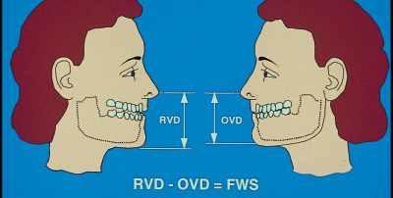
RELATION BETWEEN THE COMPONENTS
RVD – rest vertical dimension
OVD – occlusal vertical dimension
FWS – free way space

Slide 15
During the construction of complete dentures, the rest vertical dimension is determined first and then reduced or closed to the occlusal vertical dimension.
Some prosthodontists believe that the physiologic rest position tends to remain constant for variable periods of time.
Average inter occlusal distance =
2 to 4 mm

Slide 16
PHYSIOLOGIC REST POSITION
General considerations:
The position of the mandible influenced by gravity.
When a patient is tensed, under strain nervous, tired, or irritable the values vary.
In patients who suffer neuromuscular disturbances.
The duration of maintaining the rest position is usually short.
No one method can be accepted for all patients.
If no space is present between teeth in dentures, discomfort, pain, generalized hyperemia and bone resorption occurs.

Slide 17
Techniques for recording rest position
Facial measurements
Tactile sense
Phonetics
Facial expression
Anatomic land marks

Slide 18
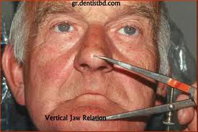
1) Facial measurements
Patient is instructed to stand or
sit comfortably with head
upright and eyes looking
straight.
A reference point is marked on the tip of patient’s nose and chin.
The patient is asked to wipe his lips with his tongue, to swallow, and to drop his shoulders.
When the mandible drops to rest position, measure the points of reference.

Slide 19
Physiologic rest position technique by Nisswonger & Thomson (1934)
Two markings are made, one on upper lip below the nasal septum, and the other on the chin.
The patient is told to swallow and relax.
The distance between the marks is measured.
The occlusal rims are adjusted until the distance between the marks is 2 to 4mm less during occlusion.

Slide 20
2) Tactile sense
Patient is asked to open his jaws wide for a period of time till patient feels uncomfortable.
Ask him to close slowly until the jaws reach a comfortable, relaxed position.
Measure the distance between the points of reference.

Slide 21
3) Phonetics
Speech is used in several different ways as an aid in establishing rest position. Two of these are,
Have the patient repeat the name Emma. When the lips contact , the jaw movement is stopped and the distance between the reference points is measured.
Engage the patient in a conversation that will divert patient’s attention. A pause in speech, followed by relaxation as indicated by a drop of the mandible, is indication for measurement.

Slide 22
4) Facial expression
By recognizing the relaxed facial expression when a patients jaw are at rest.
Lips will be even anteroposteriorly and at rest.
The skin around the eyes and over the chin will be relaxed.
These are indications for recording the rest position.

Slide 23
5) Anatomic landmarks
The Willis guide is designed to measure the distance from the pupils of the eye to the rima oris and the distance from the anterior nasal spine to the lower border of the mandible.
When these measurements are equal, the jaws are considered at rest.
Asymmetry of faces makes the value of average measurements using anatomic landmarks questionable.

Slide 24
Significance of Vertical Relation
Correct recording, transferring & incorporating the vertical relations in the prosthesis, determines the success of the prosthesis. Failure to do so may compromise the success of the prosthesis.
Effects of excessively increasing the vertical dimension:-
1) Discomfort – teeth come into contact sooner
than expected.
2) Trauma – caused by constant pressure on the
mucous membrane.
3) Loss of freeway space

Slide 25
4) Clicking of teeth – teeth are raised & the
opposing cusps frequently meet each other
during speech & mastication.
5) Appearance – over opening may cause
elongation of the face & at rest the lips
are parted.

Slide 26
Effect of excessively decreasing the vertical dimension:-
1) Inefficiency – the force exerted with the teeth in
contact decreases considerably with
over closure.
2) Cheek biting – the flabby cheek tend to become
trapped between the teeth & bitten
during mastication.
3) Appearance – Closer approximation of nose to
chin, soft tissue sag & fall in, & the
lines on the face are deepened.
4) Soreness at the corner of the mouth (Angular cheilitis) –
falling in of the corner of the mouth beyond the vermilion border & the deep fold thus formed become bathed in saliva. This area becomes infected & sore.
5) Pain in TMJ – caused due to strain of the joint &
associated ligaments.

Slide 27
VERTICAL DIMENSION AT REST (VDR)
the mandibular position assumed when the head is in an upright position and the involved muscles, particularly the elevator and depressor groups, are in equilibrium in tonic contraction, and the condyles are in a neutral, unstrained position
The distance between two selected points measured when the mandible is in the physiologic rest position.
The vertical dimension of rest is a measurable distance, a repeatable reference within an acceptable range & a useful reference when establishing the vertical dimension of occlusion.(VDO)

Slide 28
Factors to be considered for rest position as a reference are:-
1) The position of the mandible is influenced by gravity, so, mandibular positions are postural.
2) Rest position is a relaxed position of the mandible.
3) Rest position is a position in space, which cannot be maintained for definite periods of time.
4) Space between the teeth is essential when the mandible is at rest.

Slide 29
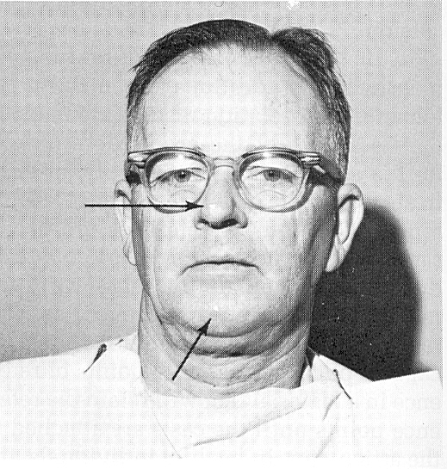
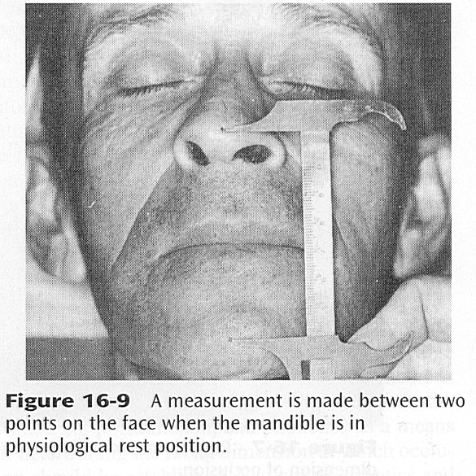
Mark two points …
One at tip of nose and one at tip of chin.
Make patient sit upright comfortable position in dental chair with head unsupported.
Patient is to asked swallow and relax and drop his shoulders.
Once dentist is sure that patient relaxed, the distance between two points are measured. This measurement is for vertical at rest.
Usually 2 or 3 readings are taken… the average is taken as reading. This prevents error during taking measurements.

Slide 30
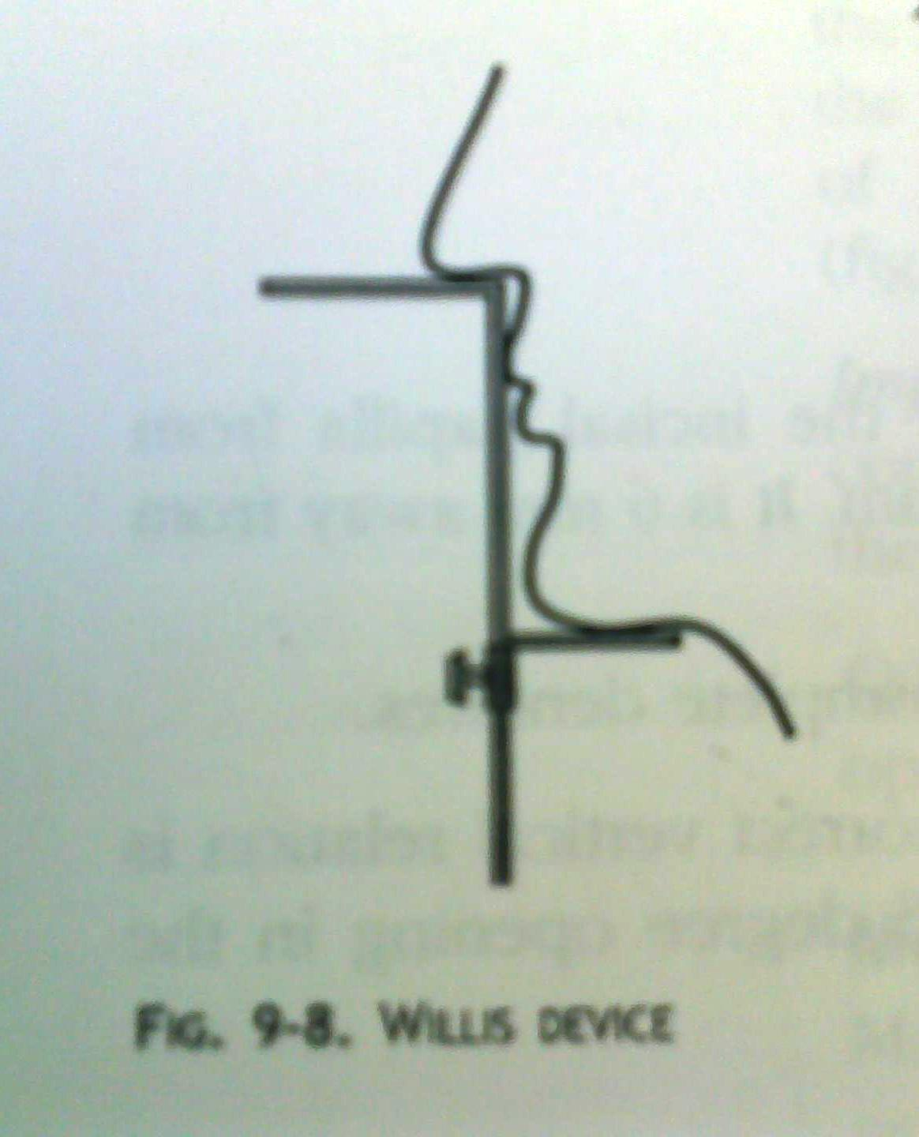
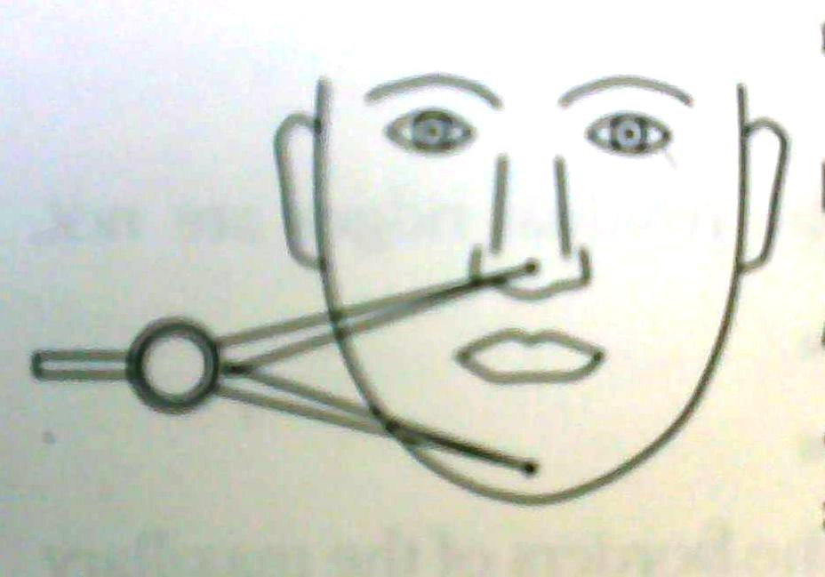

Slide 31
Vertical dimension at occlusion
the distance measured between two points when the occluding members are in contact

Slide 32
Now..
The mandibular occlusal rim is inserted and patient is asked to bite on the rims.
With patient in this occluding position, readings at same two points marked earlier is made.(niswonger’s method)
This measurement is vertical at occlusion.
Usually the VDO should be 2-4 mm less than VDR.

Slide 33
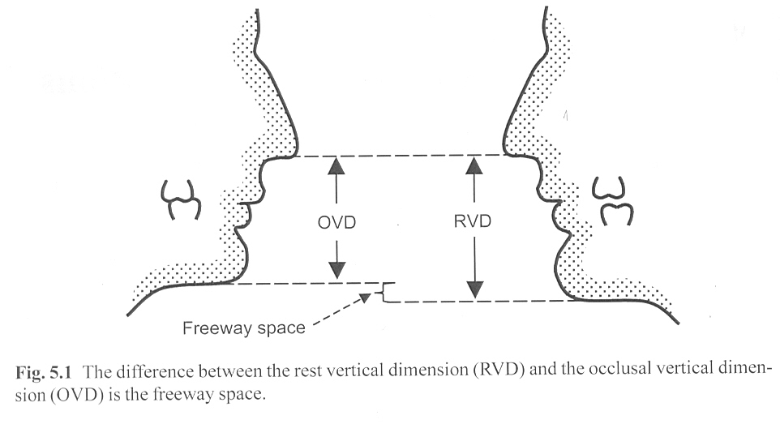
ABC:
The difference between the occlusal vertical dimension & the rest vertical dimension is the INTEROCCLUSAL DISTANCE referred to as the “FREEWAY SPACE.”
VD at occlusion = VD at rest - Freeway Space
VDO is the distance measured between two points when the occluding members are in contact.

Slide 34
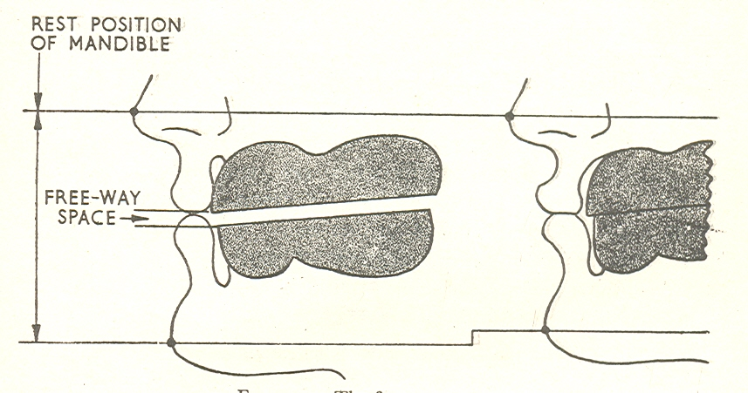
- Interocclusal Distance(free way space):- is the distance or gap existing between the upper & lower teeth when the mandible is in the physiological rest position. It is usually 2-4mm when observed in the 1st premolar region.
If the interocclusal space is greater then 4mm, the occlusal vertical dimension may be considered too small.
If less then 2mm, the dimension is considered to be too great.

Slide 35
Seat the patient in a comfortable upright position unsupported by a head rest. Mark a small dot on the nose and the chin to serve as reference points. Ask the patient to swallow and relax the jaw several times.
Use a tongue depressor blade to record the distance between the reference points when the patient's jaws are in the physiologic rest position. This measurement is the vertical relation of rest (VDR) on the tongue blade. It should be relatively constant after several repetitions.

Slide 36
Only maxillary record base and occlusion rim inserted to provide lip support.
Mark the tongue depressor blade 2-3 mm short of the vertical relation of rest. This is the vertical relation of occlusion (VDO) for most patients.
The mandibular record base and occlusion rim is adjusted by trimming the wax rim with a heated spatula or knife.
Replace the mandibular record base in the mouth and verify using the tongue blade that you have established the vertical dimension of occlusion you desire.

Slide 37
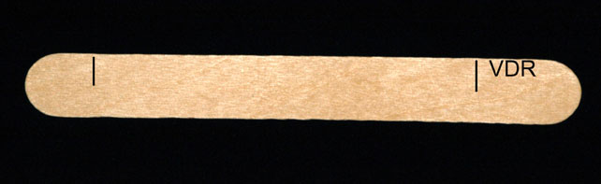
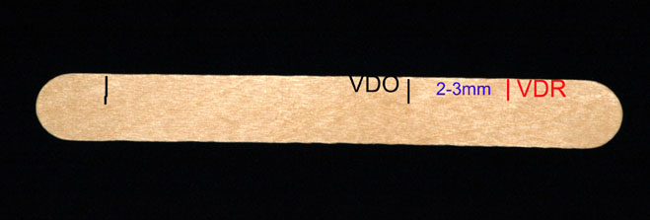

Slide 38
Facial appearance
The rest position of the mandible affects the harmony of the facial muscles. An experienced clinician can use this as a further check of the vertical relations.
If the mandible is over closed, the lips and the mandible appear protruded. If the mandible is held open from the rest position, a strained appearance can be evident when the lips are brought into contact.
Observe your patient in the established rest position. He or she should appear neither strained nor suffer a loss of vertical face height.
Ask the patient to swallow and see if he or she appears to strain to bring the teeth into contact while swallowing.

Slide 39
Phonetics
Speech movements can also be used to verify the vertical relations. The wax occlusal rims must contact evenly prior to evaluating the vertical relation of occlusion. The vertical relation of occlusion should now be verified using phonetics.
1. Place both maxillary and mandibular record bases in the patient's mouth. Ask the patient to wet the upper lip with the tip of the tongue.
2. Ask the patient to say words with "S" sounds, such as 77 ,Sunset Strip, 66, count from 1-10, or from 60-70.

Slide 40
Observe from the profile and frontal view that there is 1-2 mm of clearance between the incisal edges of the occlusion rims in the midline when the patient repeats the words containing "S" sounds. The space that exists when these words are said is called the closest speaking space.
If there is a space of 1-2 mm between the incisal edges of the maxillary and mandibular occlusal rims in the midline when the patient says an "S" sound, there should be adequate interocclusal distance.

Slide 41
If the occlusion rims contact when these words are said, then wax on the mandibular occlusion rim should be removed until this clearance is obtained.
When you are satisfied that the vertical relation of occlusal you have established is correct for your patient and your occlusion rims occlude evenly anteriorly and posteriorly, you are ready to record centric relation.

Slide 42
OTHER METHODS IN RECORDING OCCLUSION:-
1) Pre-extraction Records:-
a) Profile Photographs:-
- Profile photographs are made & enlarged to a life size of the patient.
- Measurements of anatomic landmarks on the photographs are compared with measurements using the same anatomic landmarks on the patients face.
-These measurements can be compared when the records are made & again when the artificial teeth are tried in.
- The photographs should be made with the teeth in maximum occlusion, as this position can be maintained accurately for photographic purposes.

Slide 43
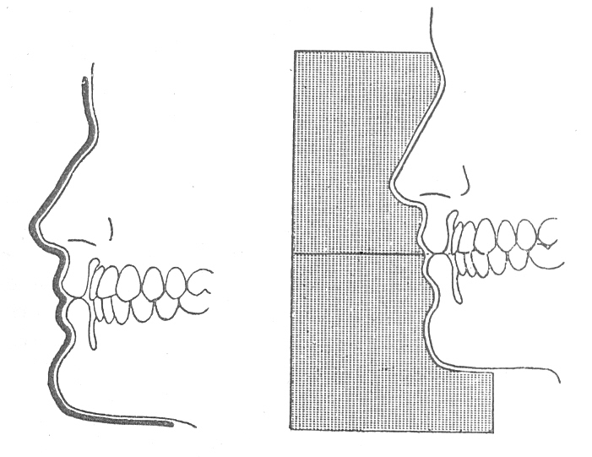
b) Profile Silhouettes:-
- The word silhouette means “outline.”
- Any further information like name, address, date, colour & shape of the teeth can be entered on the template & kept for future reference.

Slide 44
Centric relation
GPT 8 is “The maxillomandibular relationship in which the condyles articulate with the thinnest avascular portion of their respective discs with the complex in the anterior superior position against the slopes of the articular eminences. This position is independent of tooth contact. This position is clinically discernible when the mandible is directed superior and anteriorly. It is restricted to a purely rotary movement about the transverse horizontal axis”

Slide 45
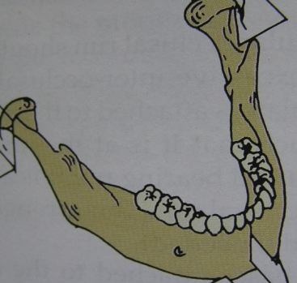
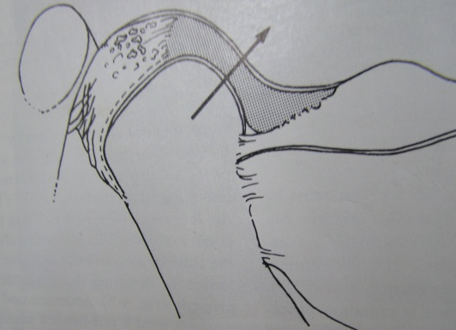
T.M.J.
TMJ
Craniomandibular articulation.
Most complex joint.
Ginglimoarthrodal joint.
Compound joint.
Articular disc
Notes:
The maxillomandibular relationship in which the condyles articulate with the thinnest avascular portion of their respective discs with the complex in the anterior superior position against the slopes of the articular eminences. This position is independent of tooth contact. This position is clinically discernible when the mandible is directed superior and anteriorly. It is restricted to a purely rotary movement about the transverse horizontal axis”

Slide 46
Significance of C.R. in C.D. pts.
It serves as a reference position for occlusal reconstruction. Artificial teeth are best set to occlude evenly at centric relation.
This position is more definite than the vertical and is independent of the presence or absence of teeth.
It is recordable and reproducible over the period of time.

Slide 47
4. Centric relation serves as reference relation for establishing an occlusion
5. An accurate C.R. record properly orients the lower cast to the opening axis of the articulator and the mandible

Slide 48
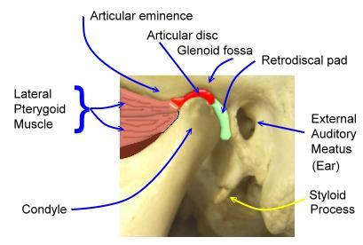
Centric relation
Anatomical

Slide 49
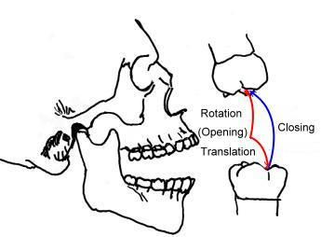
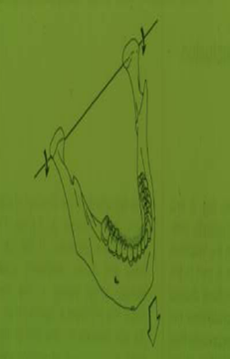
Centric relation
Geometrical

Slide 50
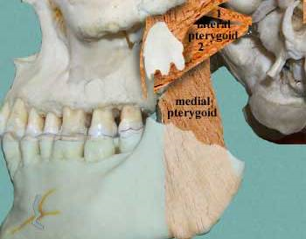
Theories of centric relation
Muscle theory

Slide 51
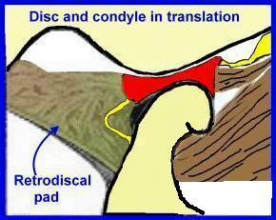
Theories of centric relation
The ligament theory

Slide 52
Theories of centric relation
Osteofibre theory

Slide 53
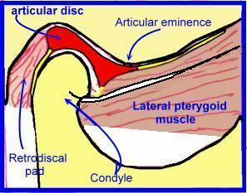
Theories of centric relation
Meniscus theory

Slide 54
Importance of centric relation
Centric relation is a reproducible and stable and comfortable position. Therefore it is used as a reference when mounting dentulous and edentulous casts in articulator.Thus CR serves as a reference relationship for establishing an occlusion.
When CR and CO of artificial teeth do not coincide the stability of denture bases is in jeopardy and patient will have unnecessary pain or discomfort.

Slide 55
Techniques
Tactile
Physiological
Pressureless
Pressure
Needlehouse
Techniques
Functional
Patterson
Intraoral
Graphic
Extraoral

Slide 56
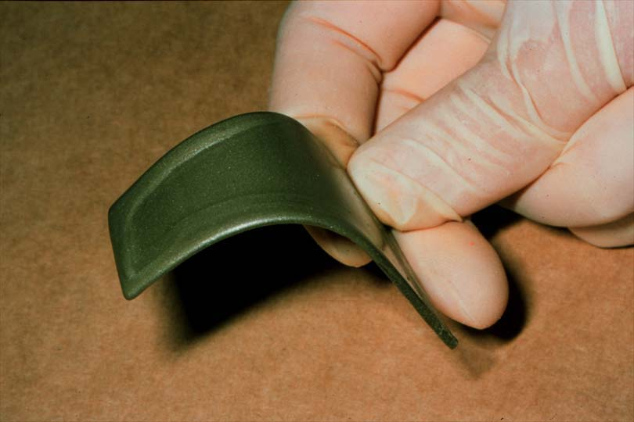
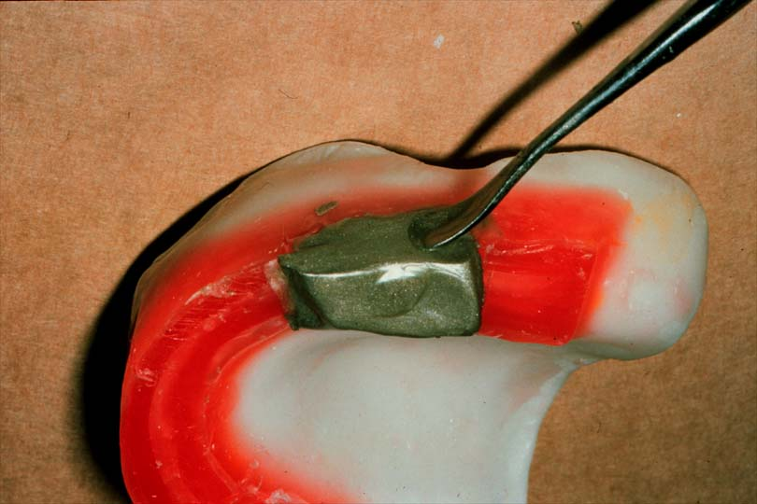
Physiological method
Materials used
Aluwax

Slide 57
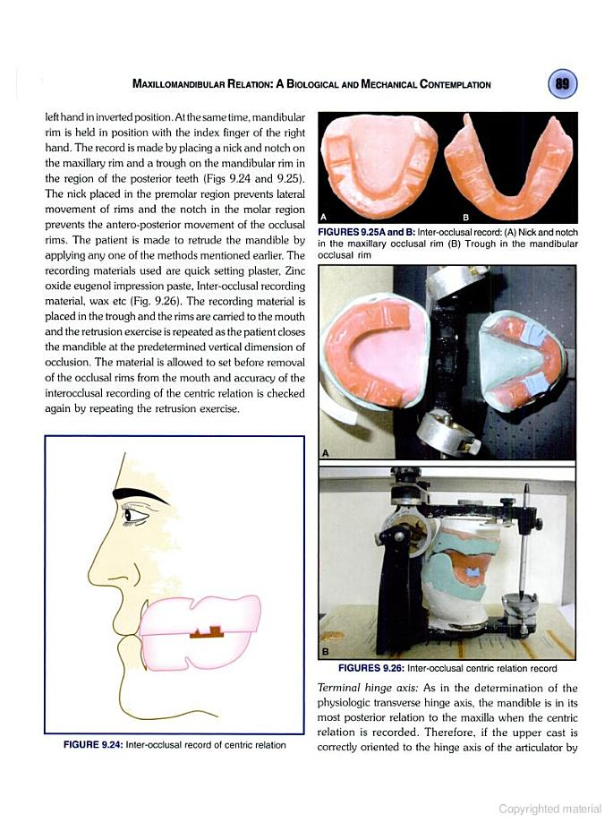
Physiological method
Nick and notch method

Slide 58
Pressure method
The lower occlusal rim is fabricated to be of excess height
occlusal rim is softened in a water bath and inserted carefully into the patient’s mouth
patient is guided to close his mouth in centric relation

Slide 59
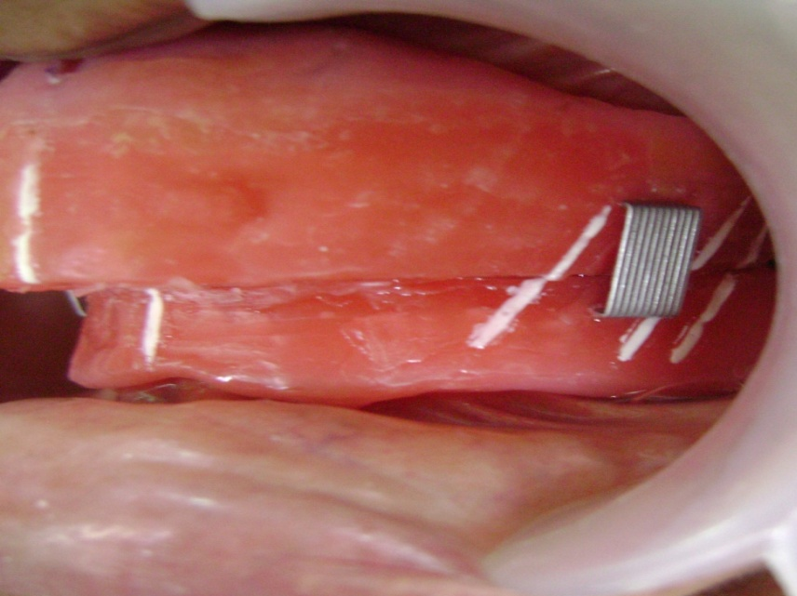
Staple pin method

Slide 60
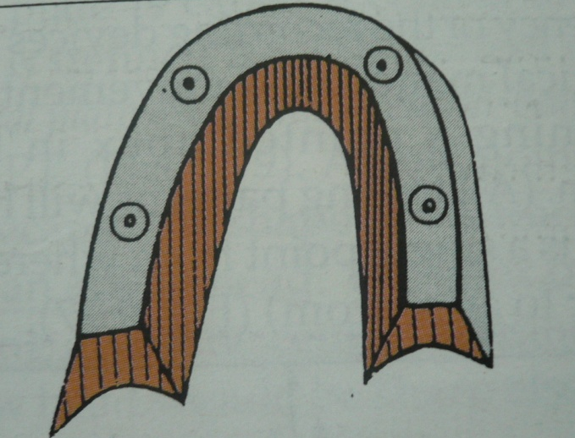
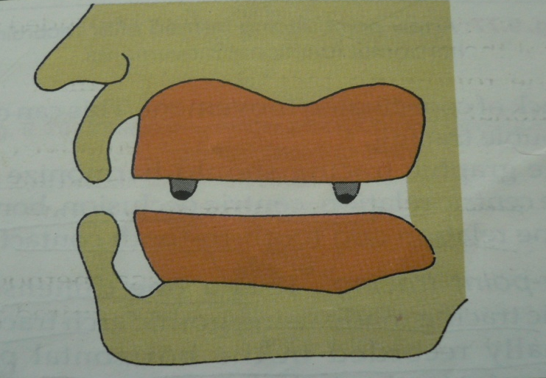
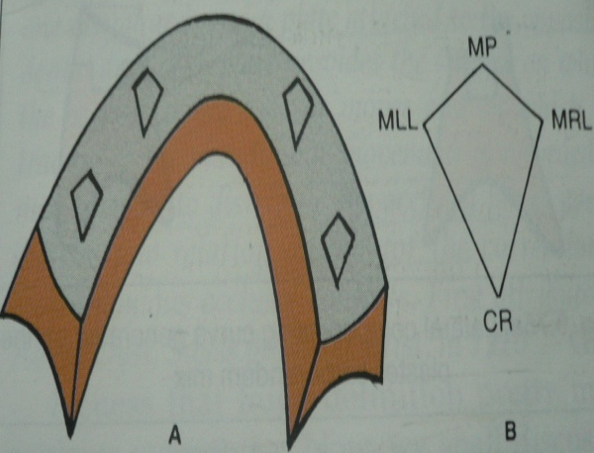
Functional or chew-in method
Needle house method
occlusion rims made of impression compound with four metal styli placed in the maxillary rim.
When the mandible moves with the styli contacting the mandiblular rim &cut four diamonds-shaped tracings.
The posterior most point of this diamond pattern indicates the centric jaw relation.

Slide 61
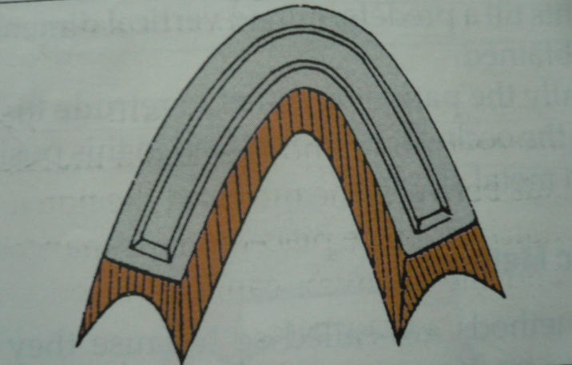
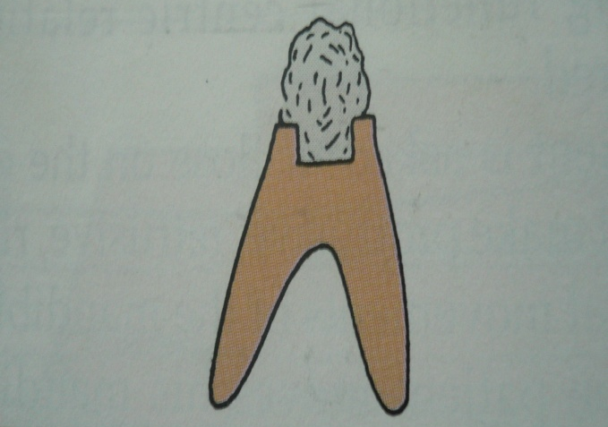
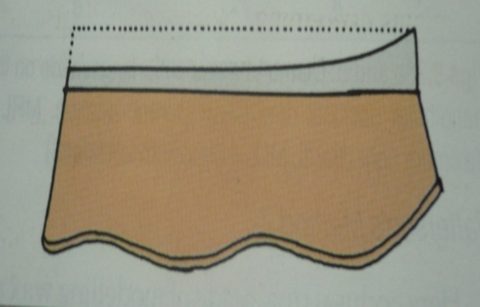
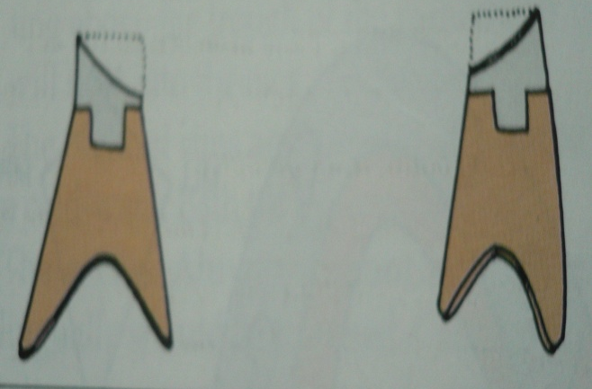
Patterson’s technique
Notes:
A trench is made in the mandibular rim
a mixture of half plaster &half pumice is placed in the trench.
The mandibular movement generates compensating curves in the plaster & pumice.
When the plaster & pumice are reduced to the pre-determined vertical dimension of occlusion, the patient is instructed to retrude the mandible & the occlusion rims are joined together.

Slide 62
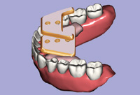
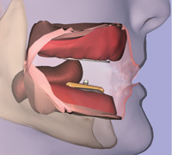
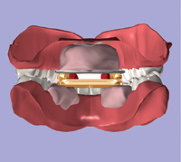
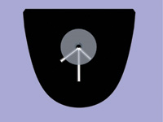
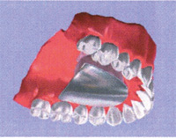
Graphic methods
Intraoral tracing device

Slide 63
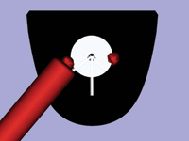
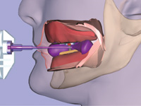
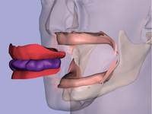
Graphic methods
INTRAORAL TRACING DEVICE

Slide 64
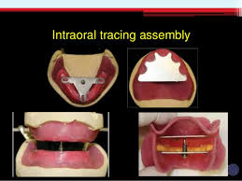

Slide 65
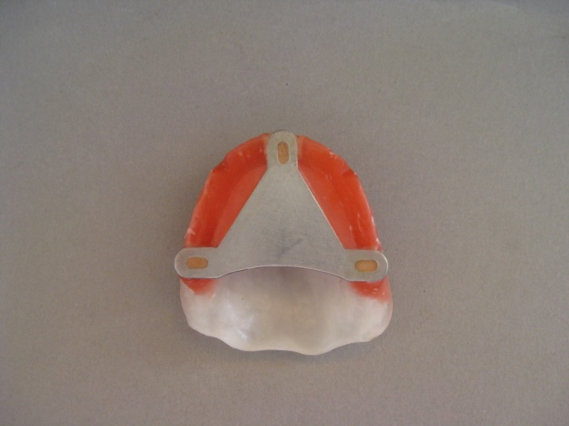
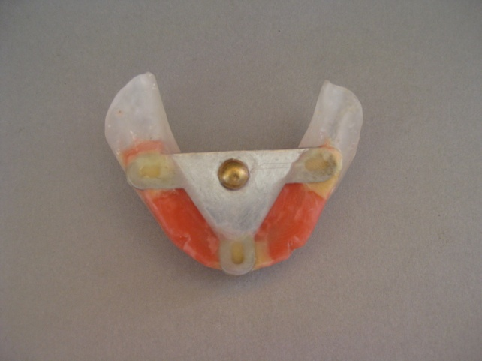
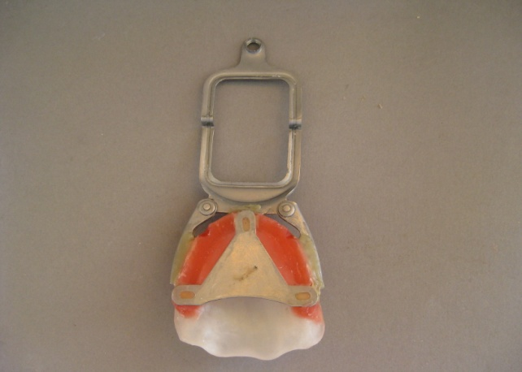
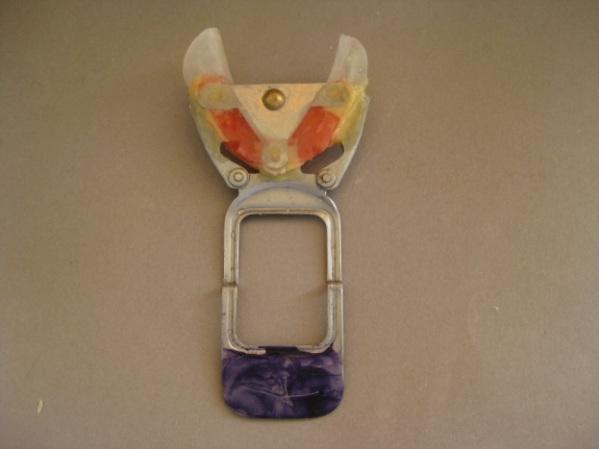
Graphic methods
Extaoral tracing device

Slide 66
Graphic methods
Extaoral tracing device

Slide 67
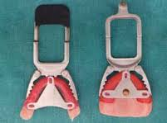
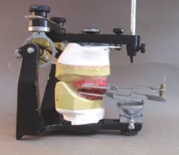


Slide 68
Indications
Well healed broad edentulous ridges.
Adequate interarch space

Slide 69
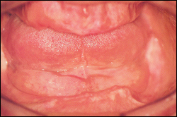

Contraindications
Severely resorbed ridges
Excessively flabby ridges
Instability of denture bases
Decreased arch space
In patients with
temporomandibular joint disorders
In patients with abnormal jaw
relation

Slide 70
Other methods of recording centric relation
Swallowing
Chin point guidance
Chin point guidance with anterior jig
Bilateral manipulation

Slide 71


Swallowing

Slide 72

Chin point guidance

Slide 73

Chin point guidance with anterior jig

Slide 74

Bilateral manipulation

Slide 75
RECORDING OF CENTRIC RELATION
There are two aspects :
1.Assisting the patient to retrude the mandible
2.Recording.

Slide 76
Effective manipulation of mandible requires delicacy and firmness.
METHODS FOR ASSISTING THE PATIENT TO RETRUDE THE MANDIBLE.
Relaxing the jaw and closing
Repeatedly protruding and retruding the mandible
Swallowing and closing
Tapping the rims or back teeth repeatedly
Touching the tip of the tongue to the posterior aspect of the palate or denture border and bite.
Palpate the temporal and massater muscles to relax them.

Slide 77


Registering Centric Relation
Max & Mand Occusion Rims
  Two sharp “V”-shaped notches in the molar/premolar area of each sided wax
  Depth 1-2 mm
1-2 mm

Slide 78



Thin Layer of Material

Slide 79

Alternate Medium
  Aluwax
  Must be very soft

Slide 80

Registering Centric Relation
  Place Alluwax into a 1-2mm slot in maxillary rim
  Fill to slight excess
  Ensure wax is dead soft
  Hot water bath for softening

Slide 81

Registering Centric Relation
  Rehearse making the record without recording medium
  Place occlusion rims intraorally
  Have patient close into record
  Ensure smooth arc of closure, no horizontal deviations
  Use index fingers to stabilize lower record base

Slide 82

STATIC OR PRESSURELESS METHOD:

Slide 83

The sealed occlusal rims are removed from the patient’s mouth.
The record should be reverified if there is doubt in its accuracy.
Using this record the maxillary and mandibular casts are mounted on articulator.
Next step is arrangement of teeth in the laboratory.

Slide 84

THANK YOU

